Slide 1


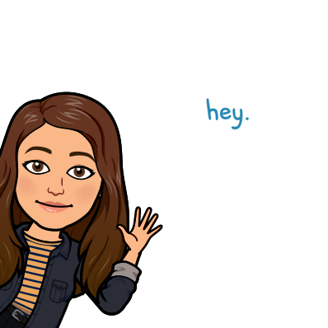
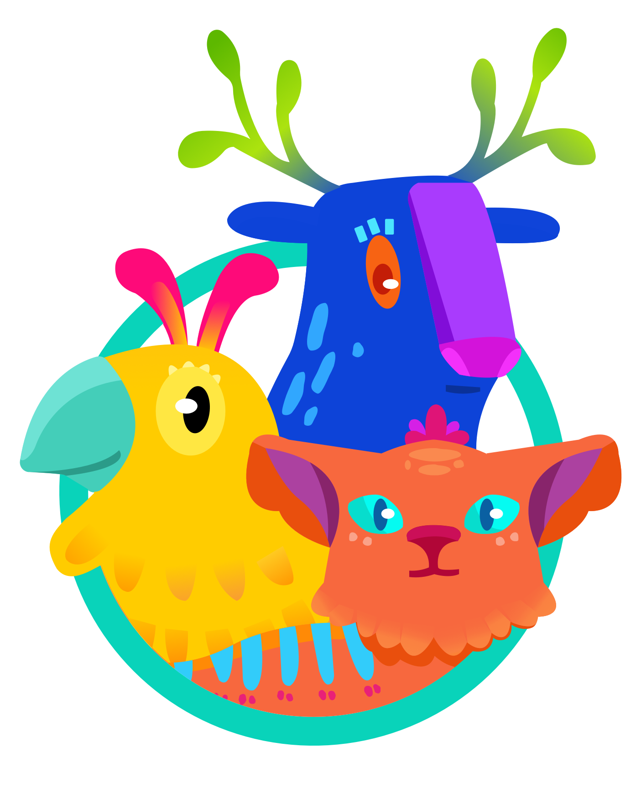
Digital Classroom Assets
We thought you might like
some Amplify Reading assets
for your Bitmoji Classroom!
Notes:
Educators, We want you and your students to get excited about Amplify Reading! Our design team created this deck of digital assets that can be used with your virtual classroom. We believe in building a community of readers- ready to take on their own adventures in the town of Bookerton.
Teacher Tip-
If you have your own Bitmoji, use them with these slides!

Slide 2




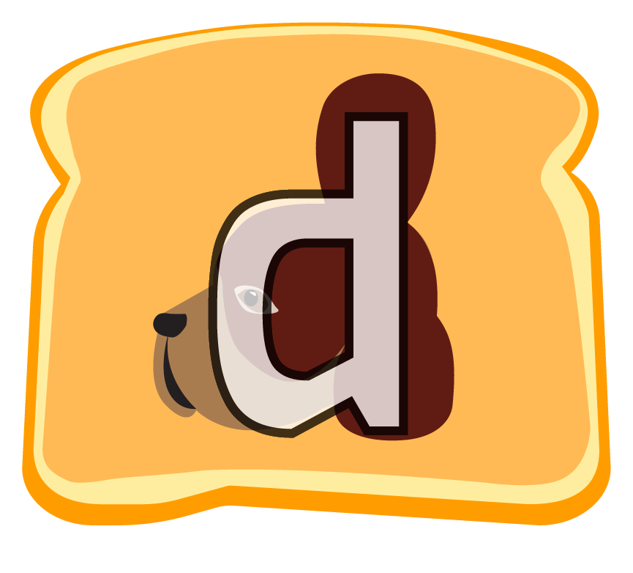

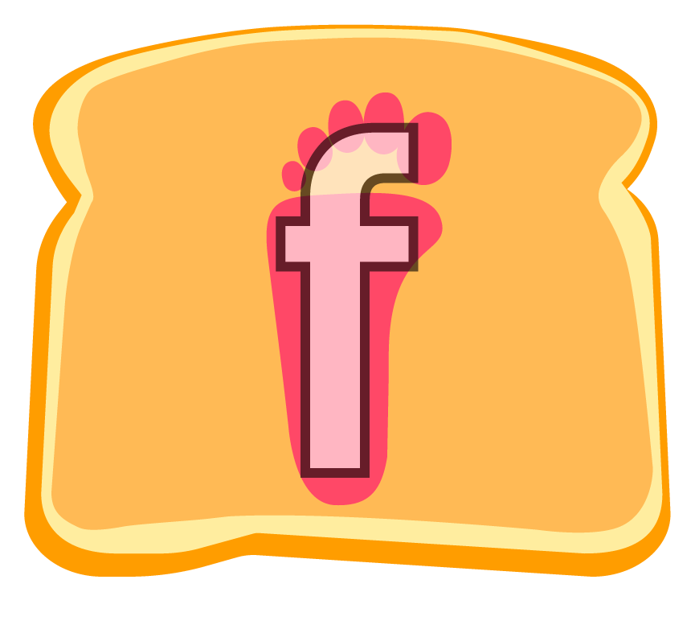




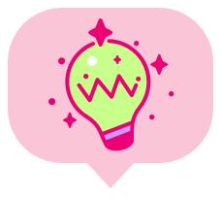


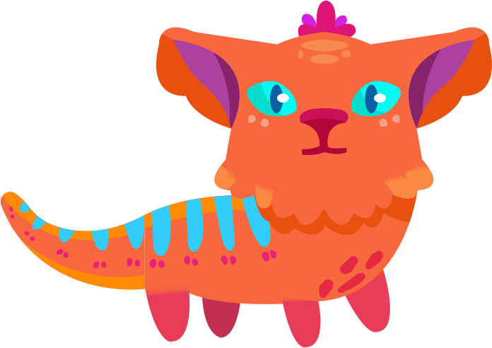

Keep going!
You’re growing!
Curioso!
Notes:
Taking the time and finding ways to connect with students is more important than ever. Our Amplify Reading characters and digital classroom settings will allow teachers to find creative ways to engage with the progress of their readers.
Teacher Tip-
Amplify Reading class check-in. Use this slide as your Monday launch to the week or as your Friday wrap-up.
K-1: Show me with your fingers, how many times did you log into Amplify Reading this/last week? Those of you that played 3x this week, what’s your trick to meeting your Amplify Reading goal? Can anyone tell me about a new game you played? Can someone tell me a game that was hard for you?
3-5: Who wants to guess the total number of minutes our class was on Amplify Reading this/last week? Those of you that went beyond 30-45 mins, what’s your trick to meeting your Amplify Reading goal? Can someone share a game you played? Was there a game that was hard for you?

Slide 3
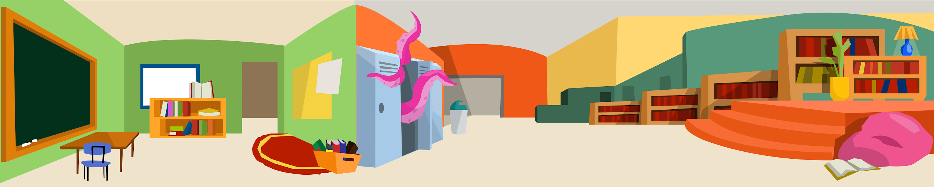

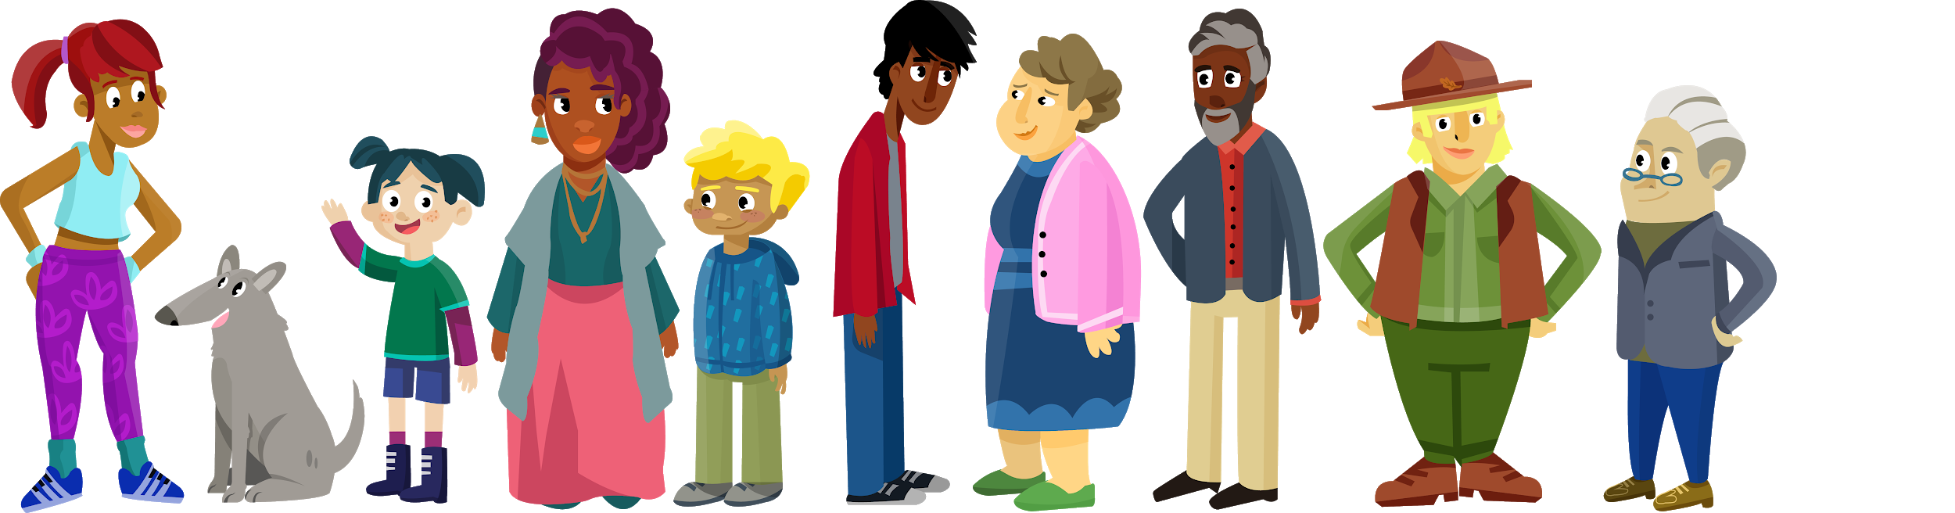
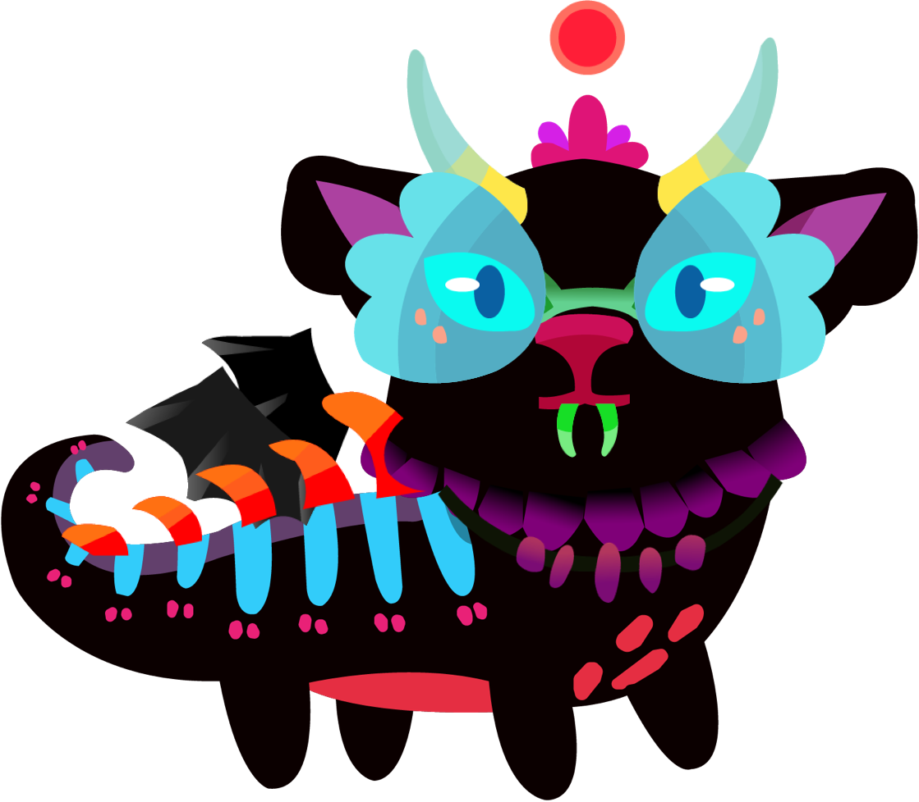
Classroom Location
I wonder what
we will learn today!
Notes:
Explicitly state learning goals. Remote learning has made it even more challenging for students to understand what they are doing and why they are doing it in front of a digital device.
Teacher Tip-
Use this slide as your opening slide each day and/or to wrap up a lesson.
Today, we will learn how to…
By the end of this week, we will be able to...

Slide 4



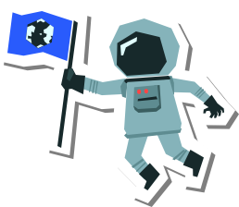
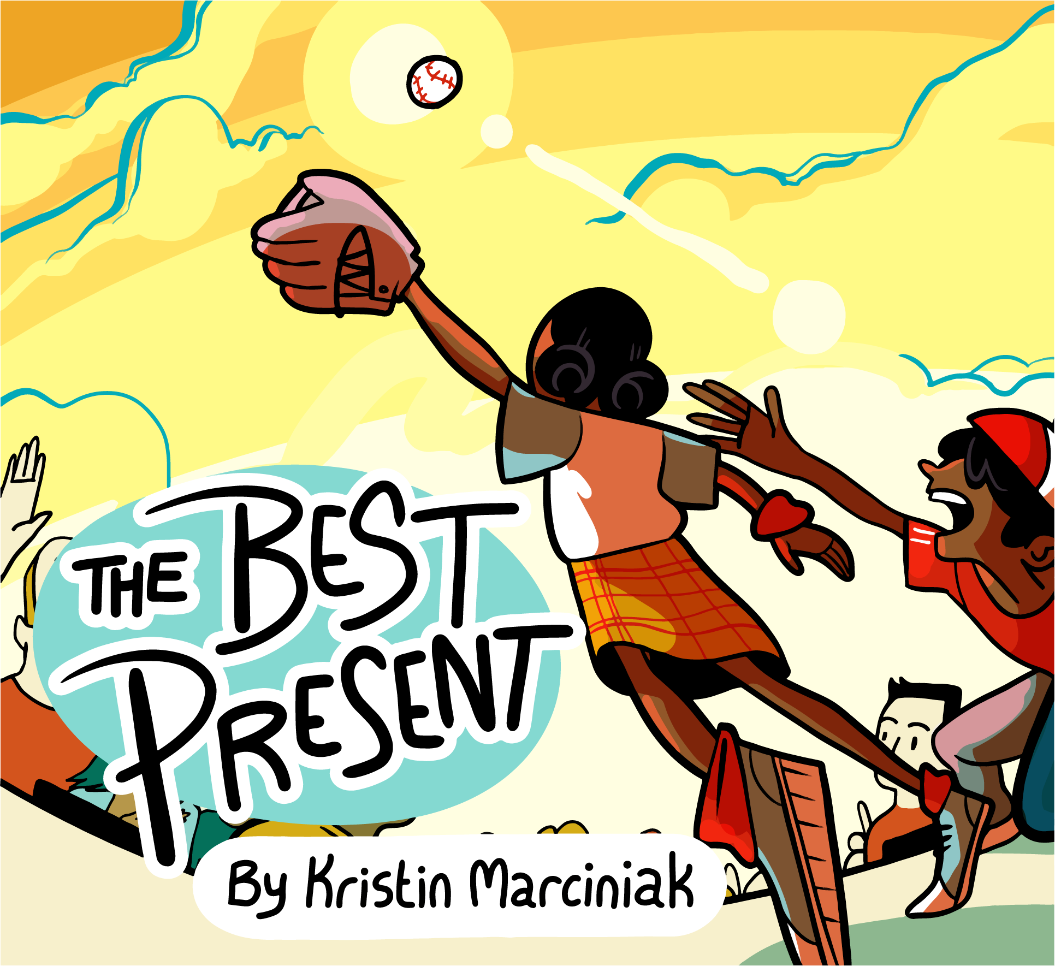




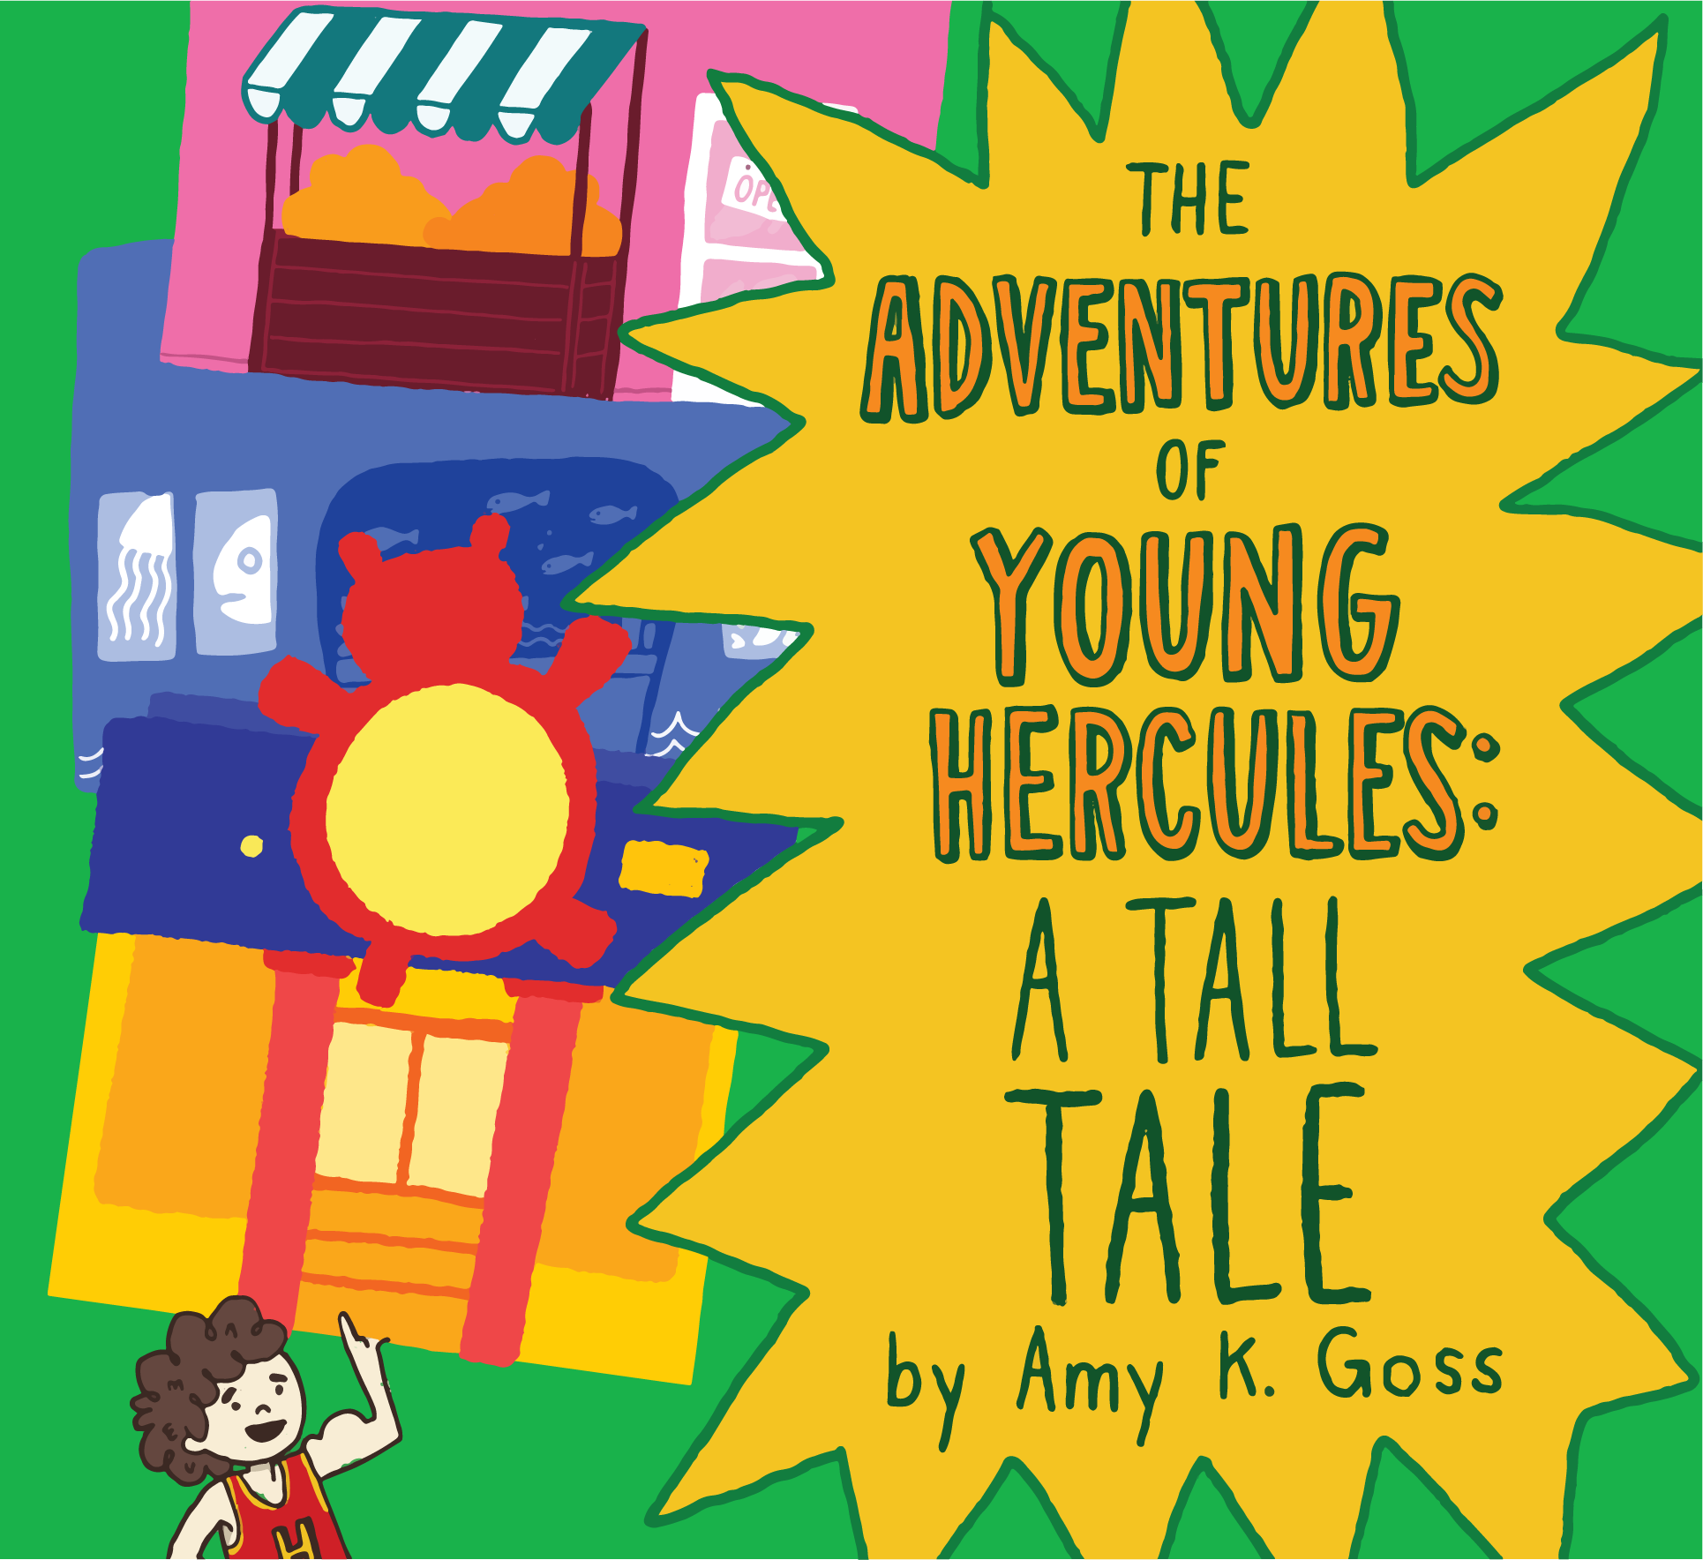
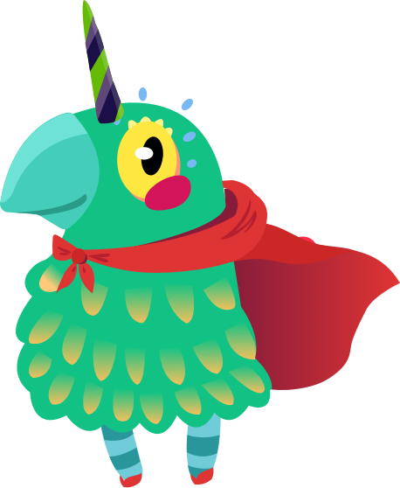
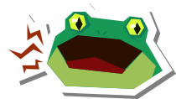
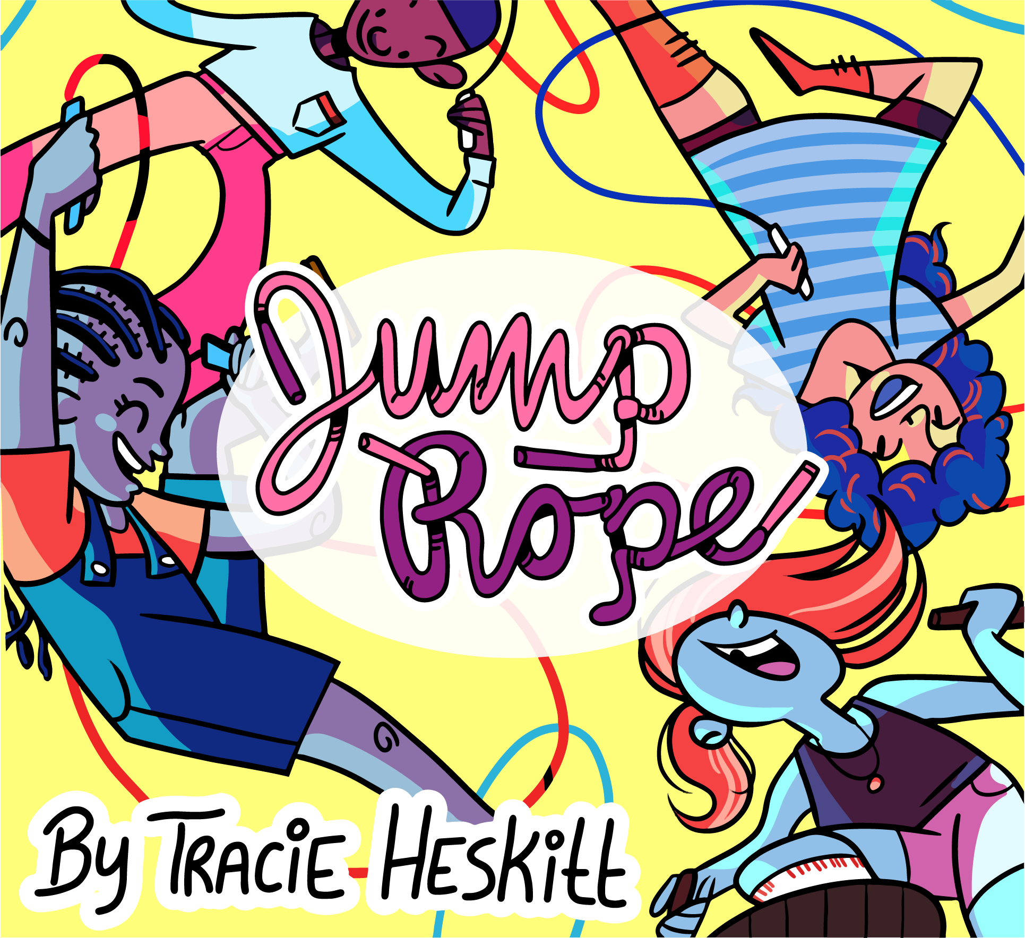

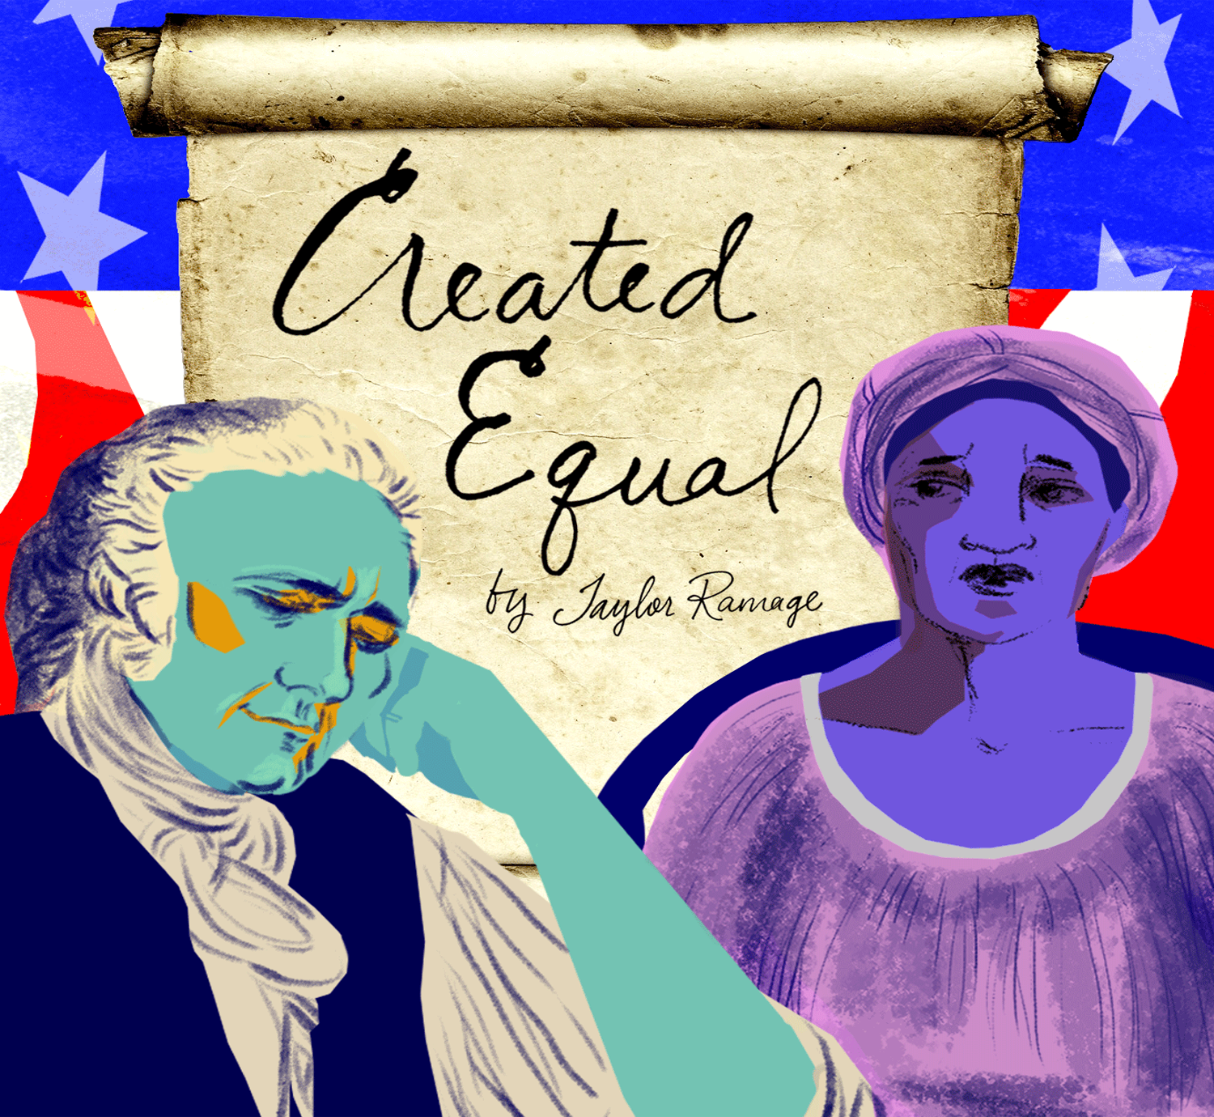
Let’s pick a
book to read!
Curioso!
Notes:
Read alouds are still important. Even if they are done virtually. Don’t forget to continue to include reading strategies as you’re reading to your class. Have them predict, ask questions, make observations, summarize, note vocabulary, discuss story elements, etc.
Teacher Tip-
Build your classroom bookshelf together. As you read stories together, you might want to add it to the classroom bookshelf and watch it grow.
Include the cover of the books you will read to the class. There might be times that you allow the students to vote on which one they want you to read.
Bookshelves could even be designed to capture the theme for the month.

Slide 5
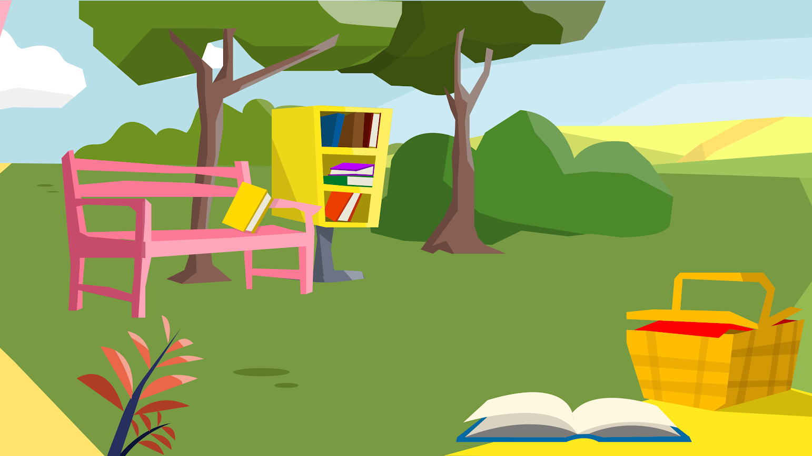
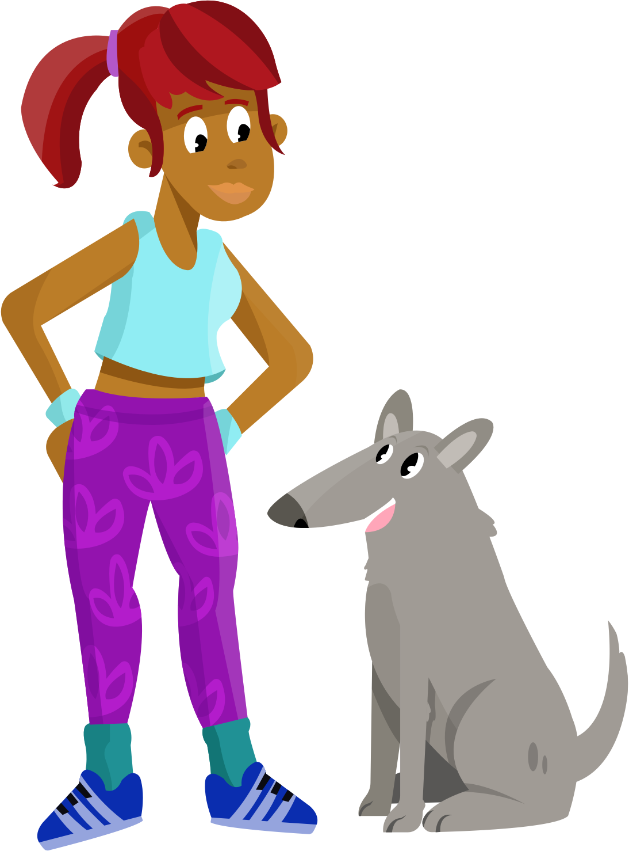
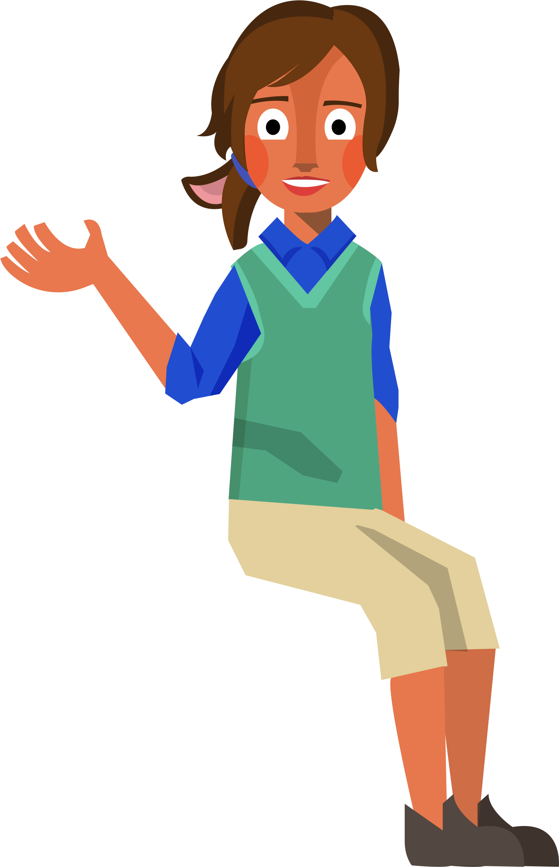

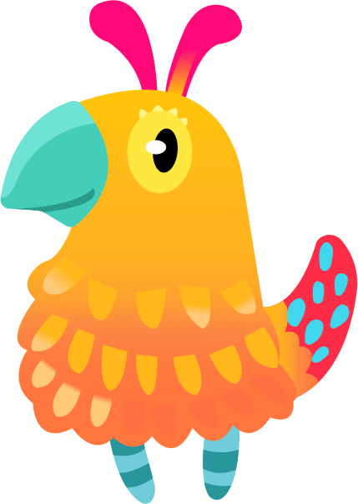
Bookerton Map
Did you
Bring a book with you?
Notes:
Now it’s their turn! Have your students share one of their favorite books.
Teacher Tip-
Teachers can generate a list of the titles shared by the class and share it with caregivers. Who else can get kids to read? Other kids!

Slide 6
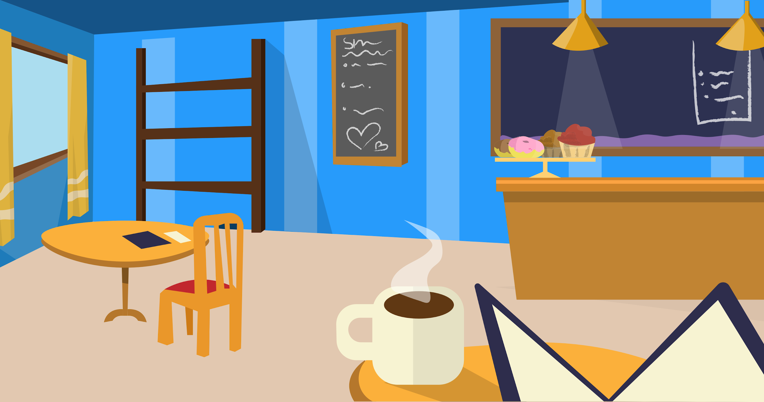

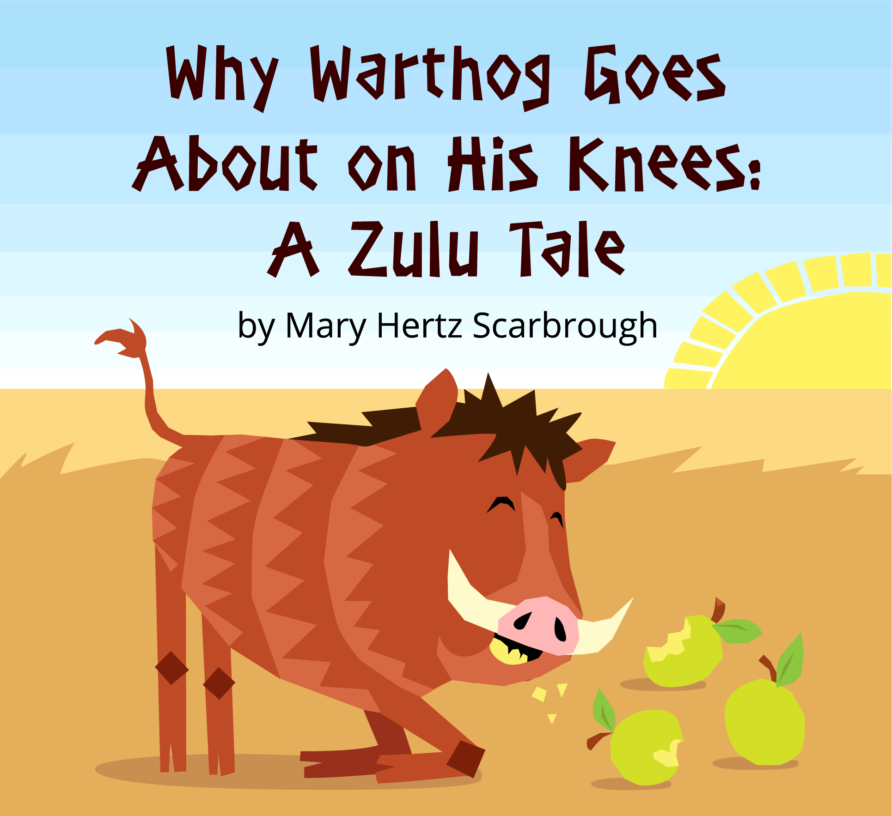
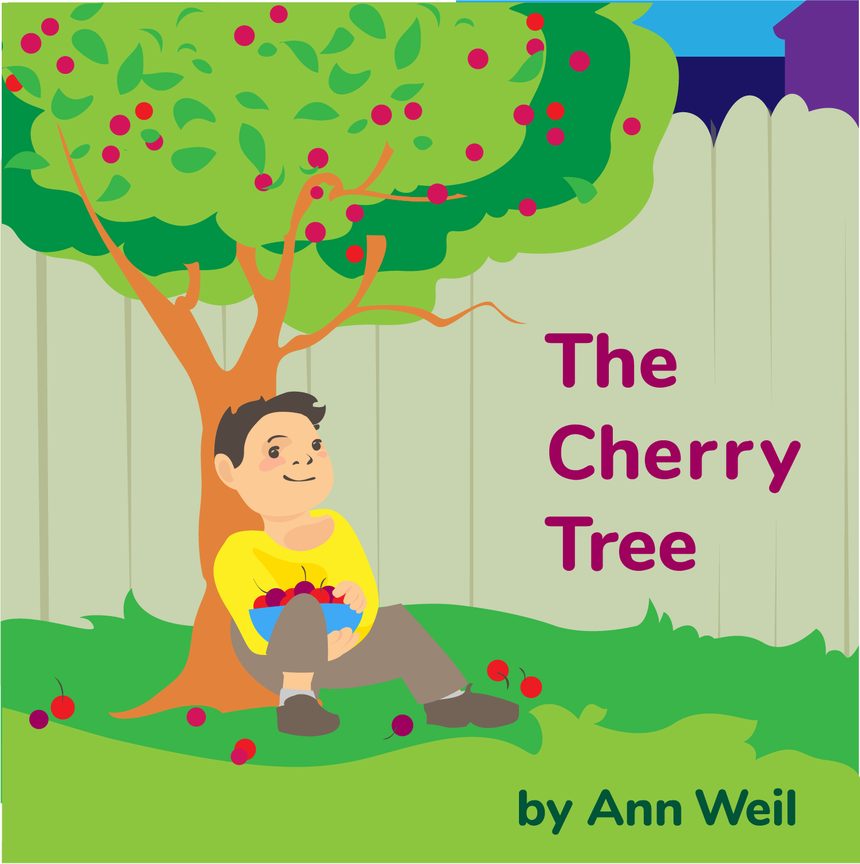
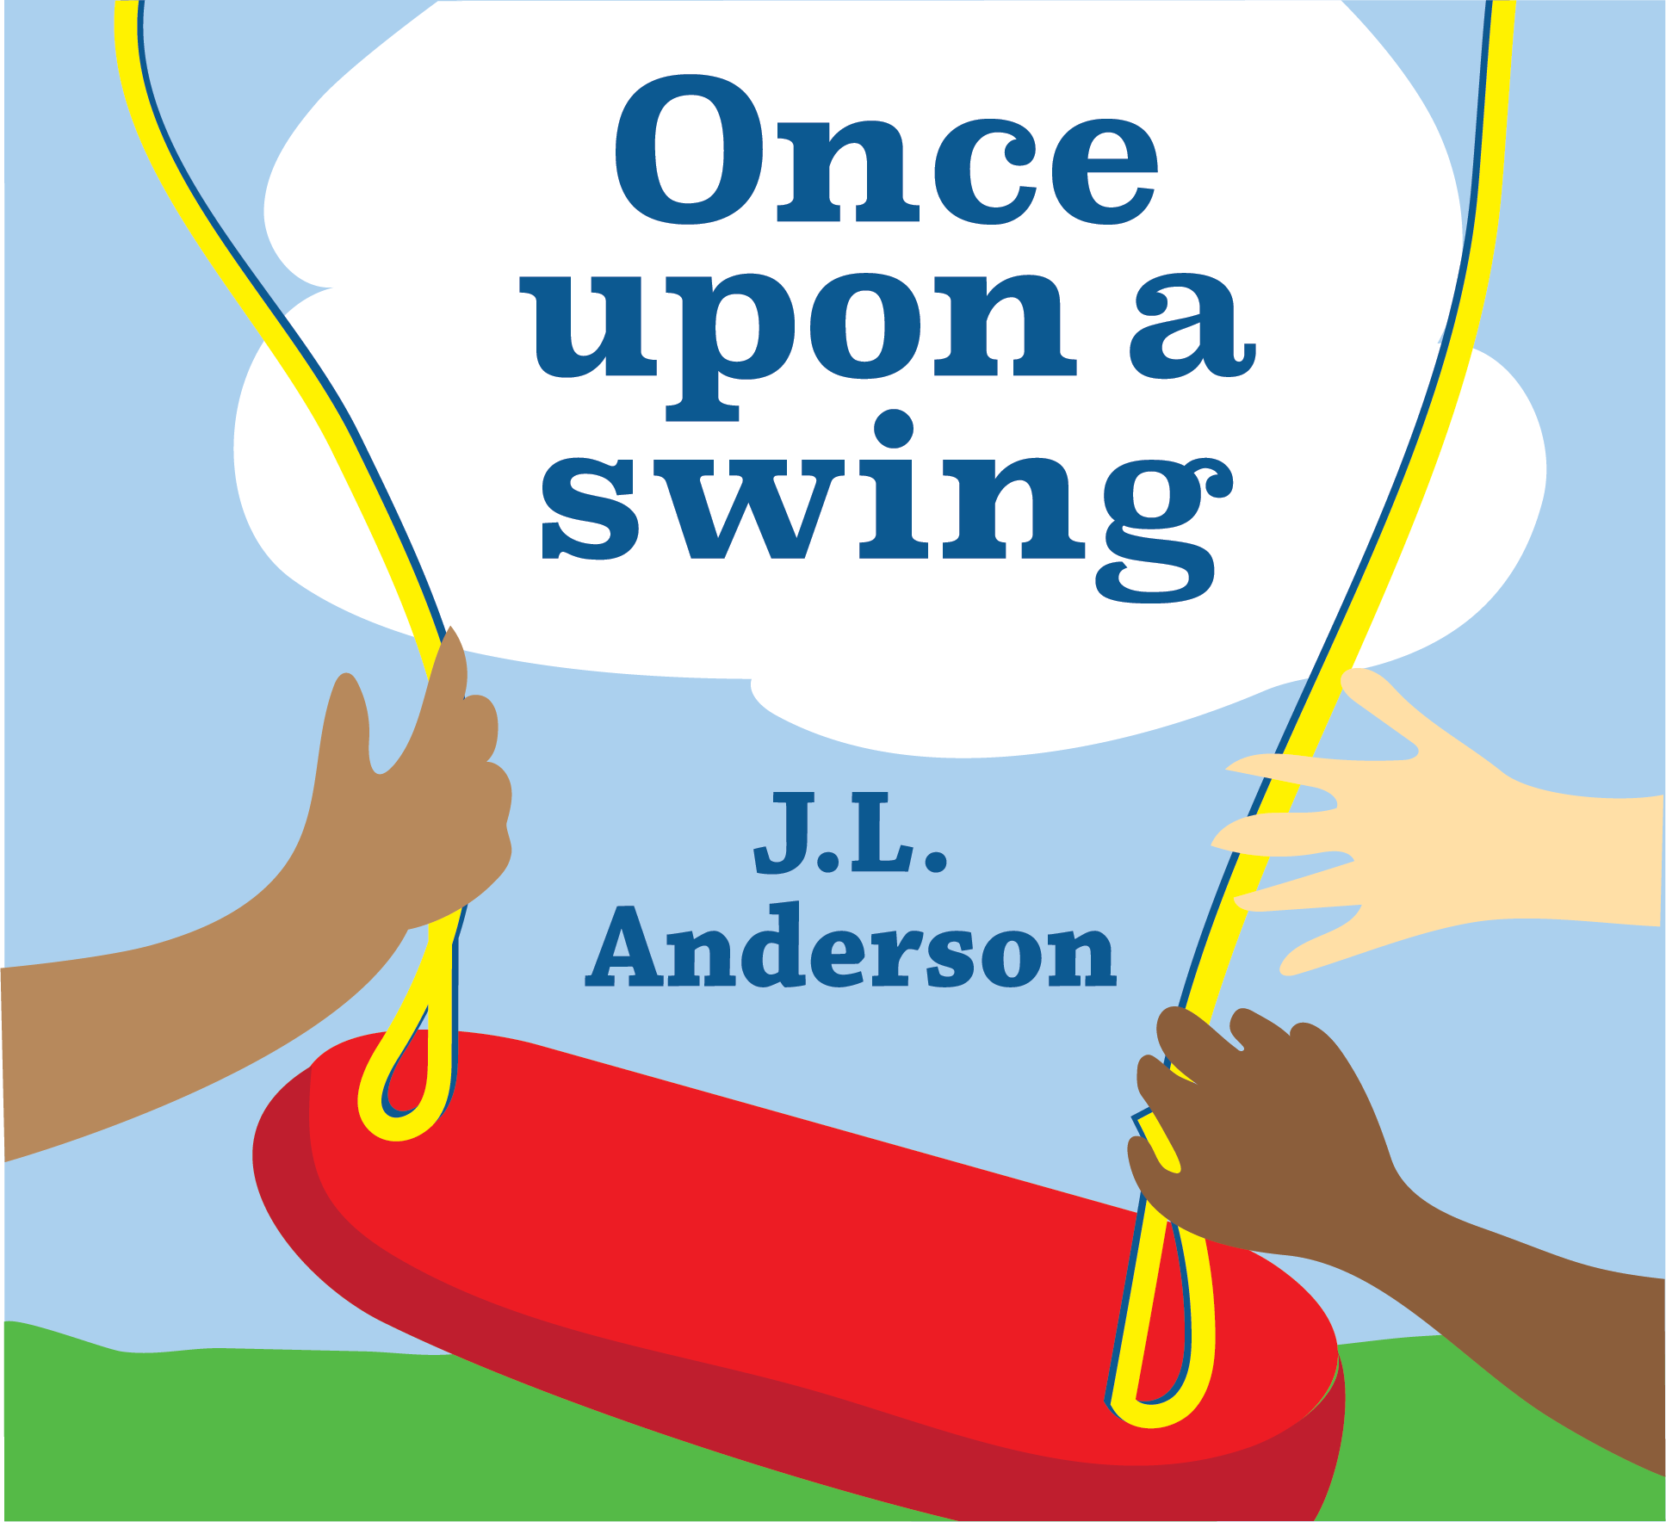

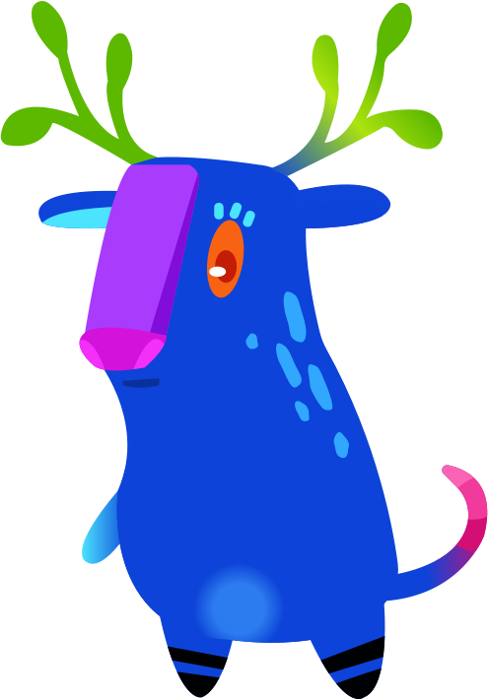
Cafe Location
Gosh! I need
books for my shelves.
Notes:
The more your kids are on Amplify Reading, the more “books” they are adding to their book-self. It’s important that you keep them motivated and show them that we are all a community of readers.
Teacher Tip-
Play Amplify Reading games with your class! Go to your Amplify Reading teacher account, click on Demo, select your grade level, and share your screen with your class. Play, struggle, problem-solve, and build skills with the help of your class. If you make it fun, your students will be excited to go on their own Amplify Reading adventure.
If you feel that the usage is dropping, or there are trouble spots on a particular game, pull up the demo and play together!

Slide 7
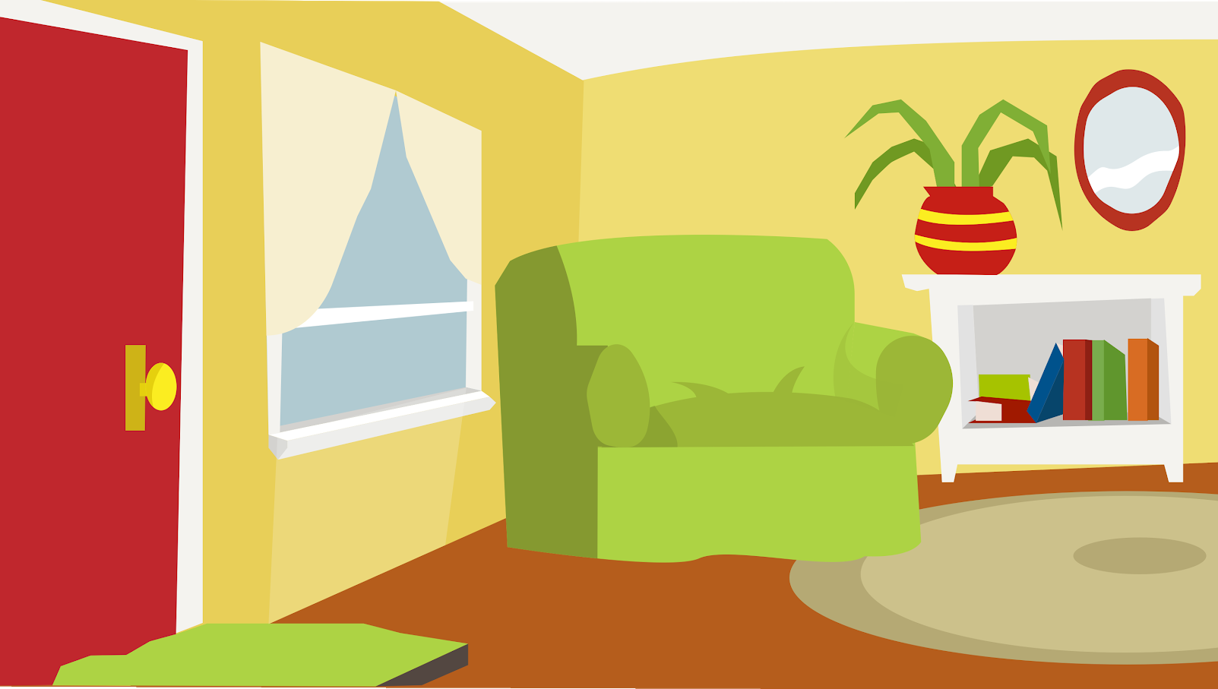
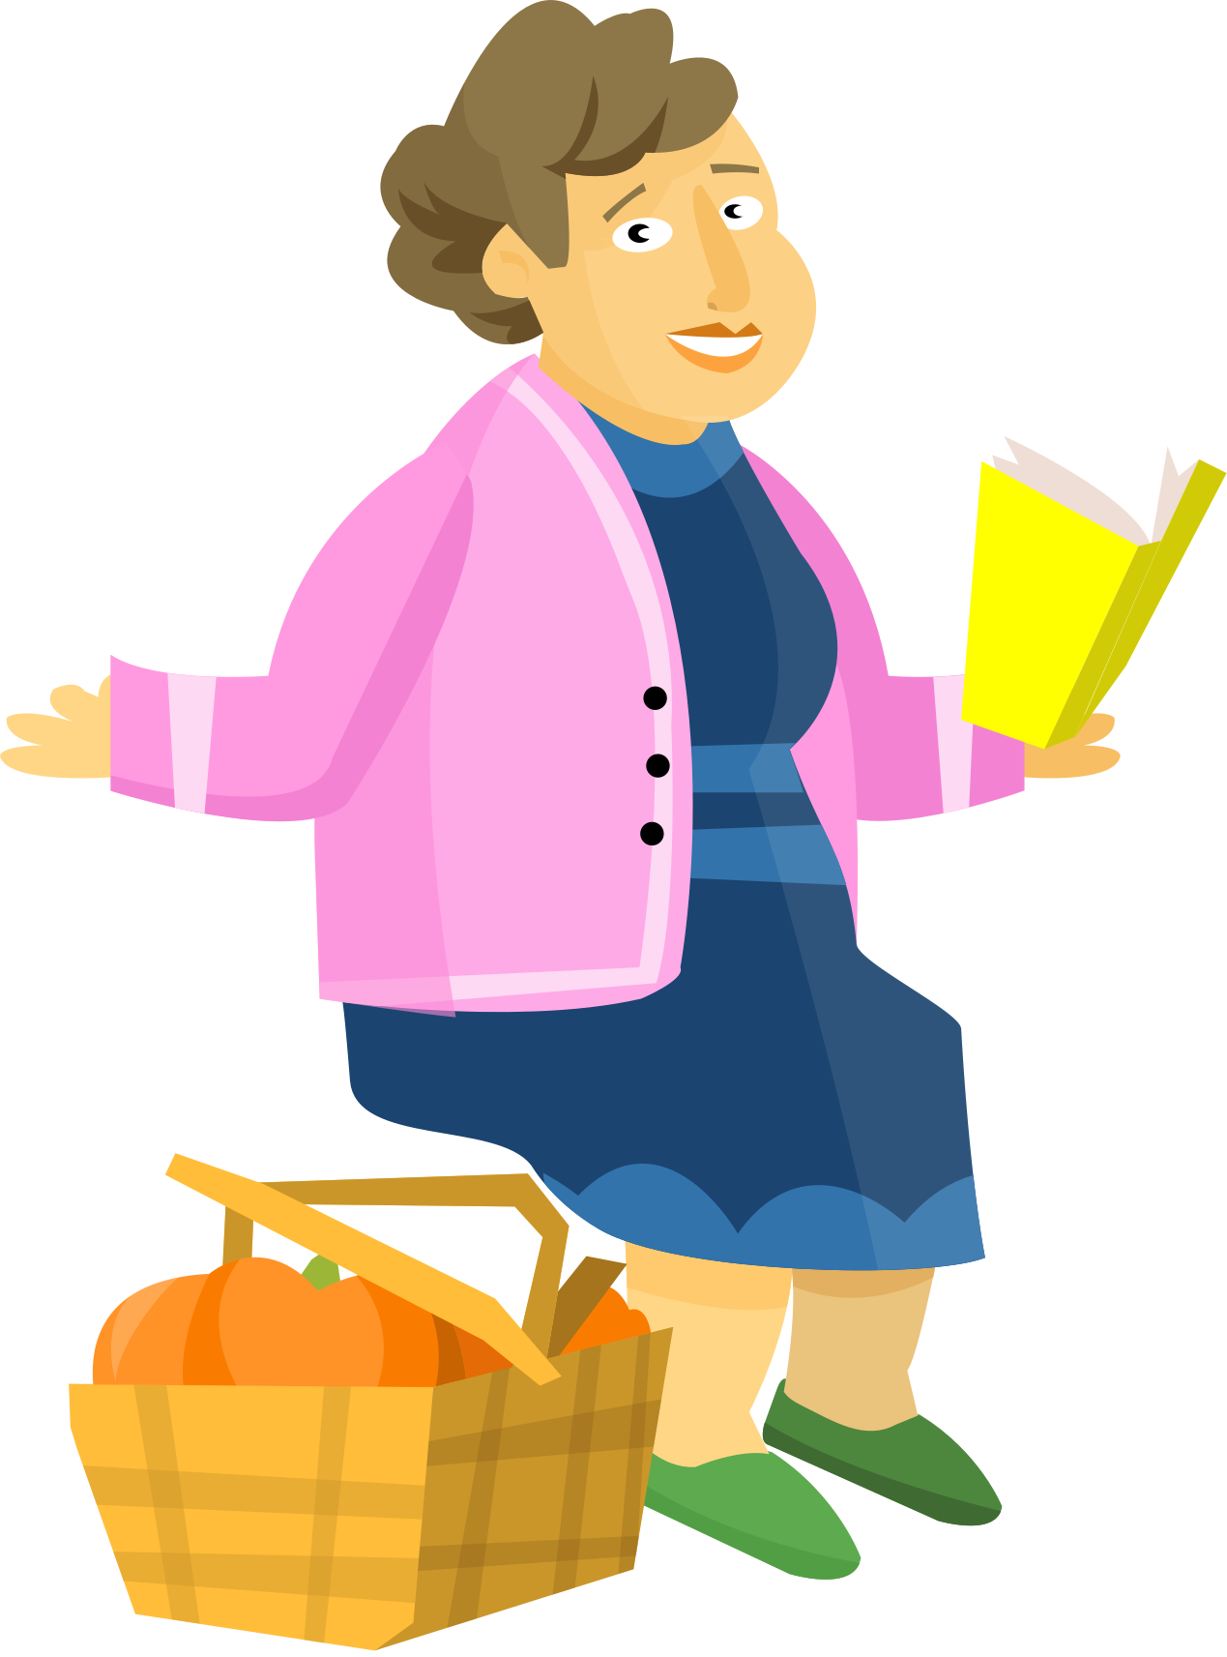
Home Location
This is my
favorite topic -
Gardening!
Notes:
What is your favorite… ? Do you know what your kids enjoy reading or hearing about? Do they know what your favorite topics are?
Teacher Tip-
Use this slide to connect with your students. (The text in the speech bubble can be edited and the image can be swapped out for another Bookerton community member from Slide 10.)

Slide 8
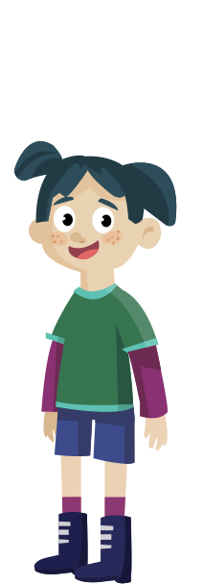

Library Location
Let’s pick a book to read!
Notes:
Our caregivers are our partners in this. Take some time to meet them, thank them, and recognize them.
Teacher Tip-
You can use this slide to have an All About Me (and My Family) featuring one of your students.

Slide 9
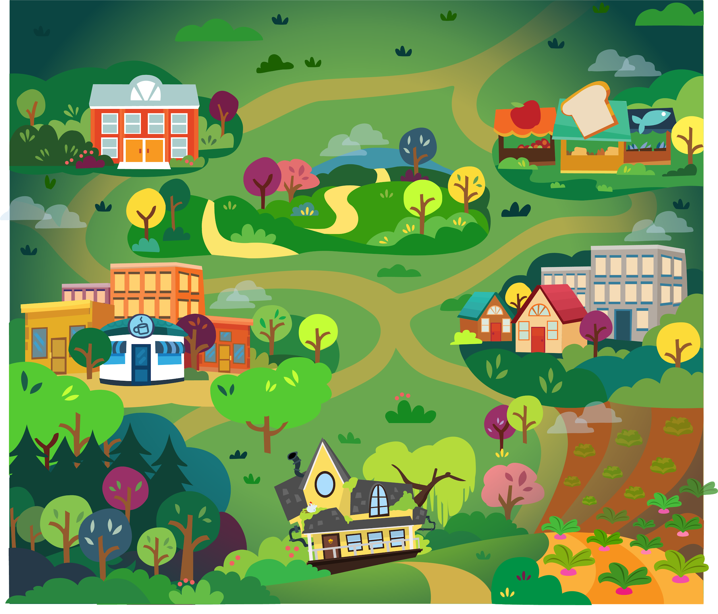
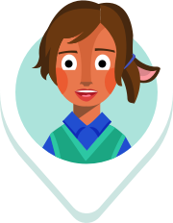
Bookerton Map
Notes:
This is the town of Bookerton. You and your students can be a part of this reading community.
Teacher Tip-
As your students meet their usage goals, you can add more and more members to the map.

Slide 10
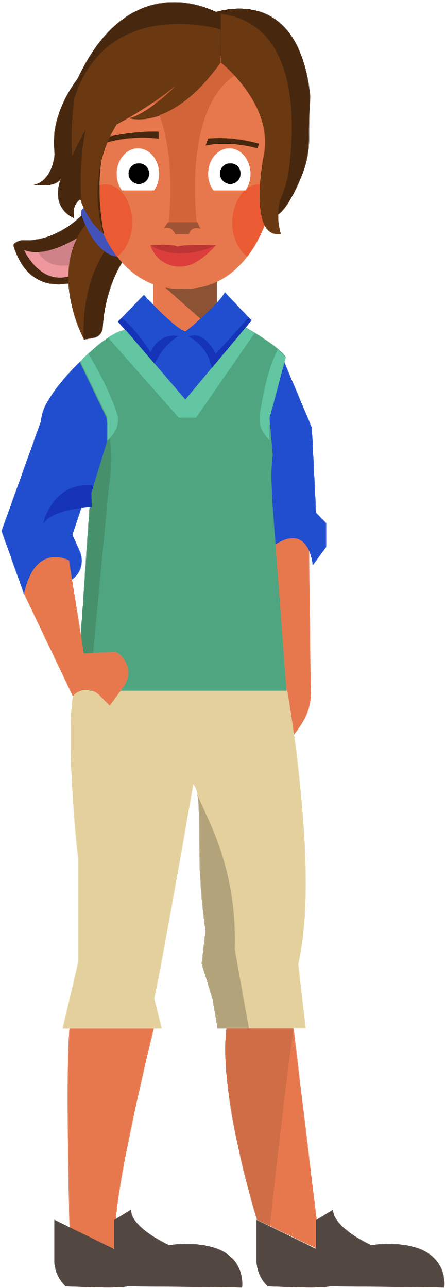
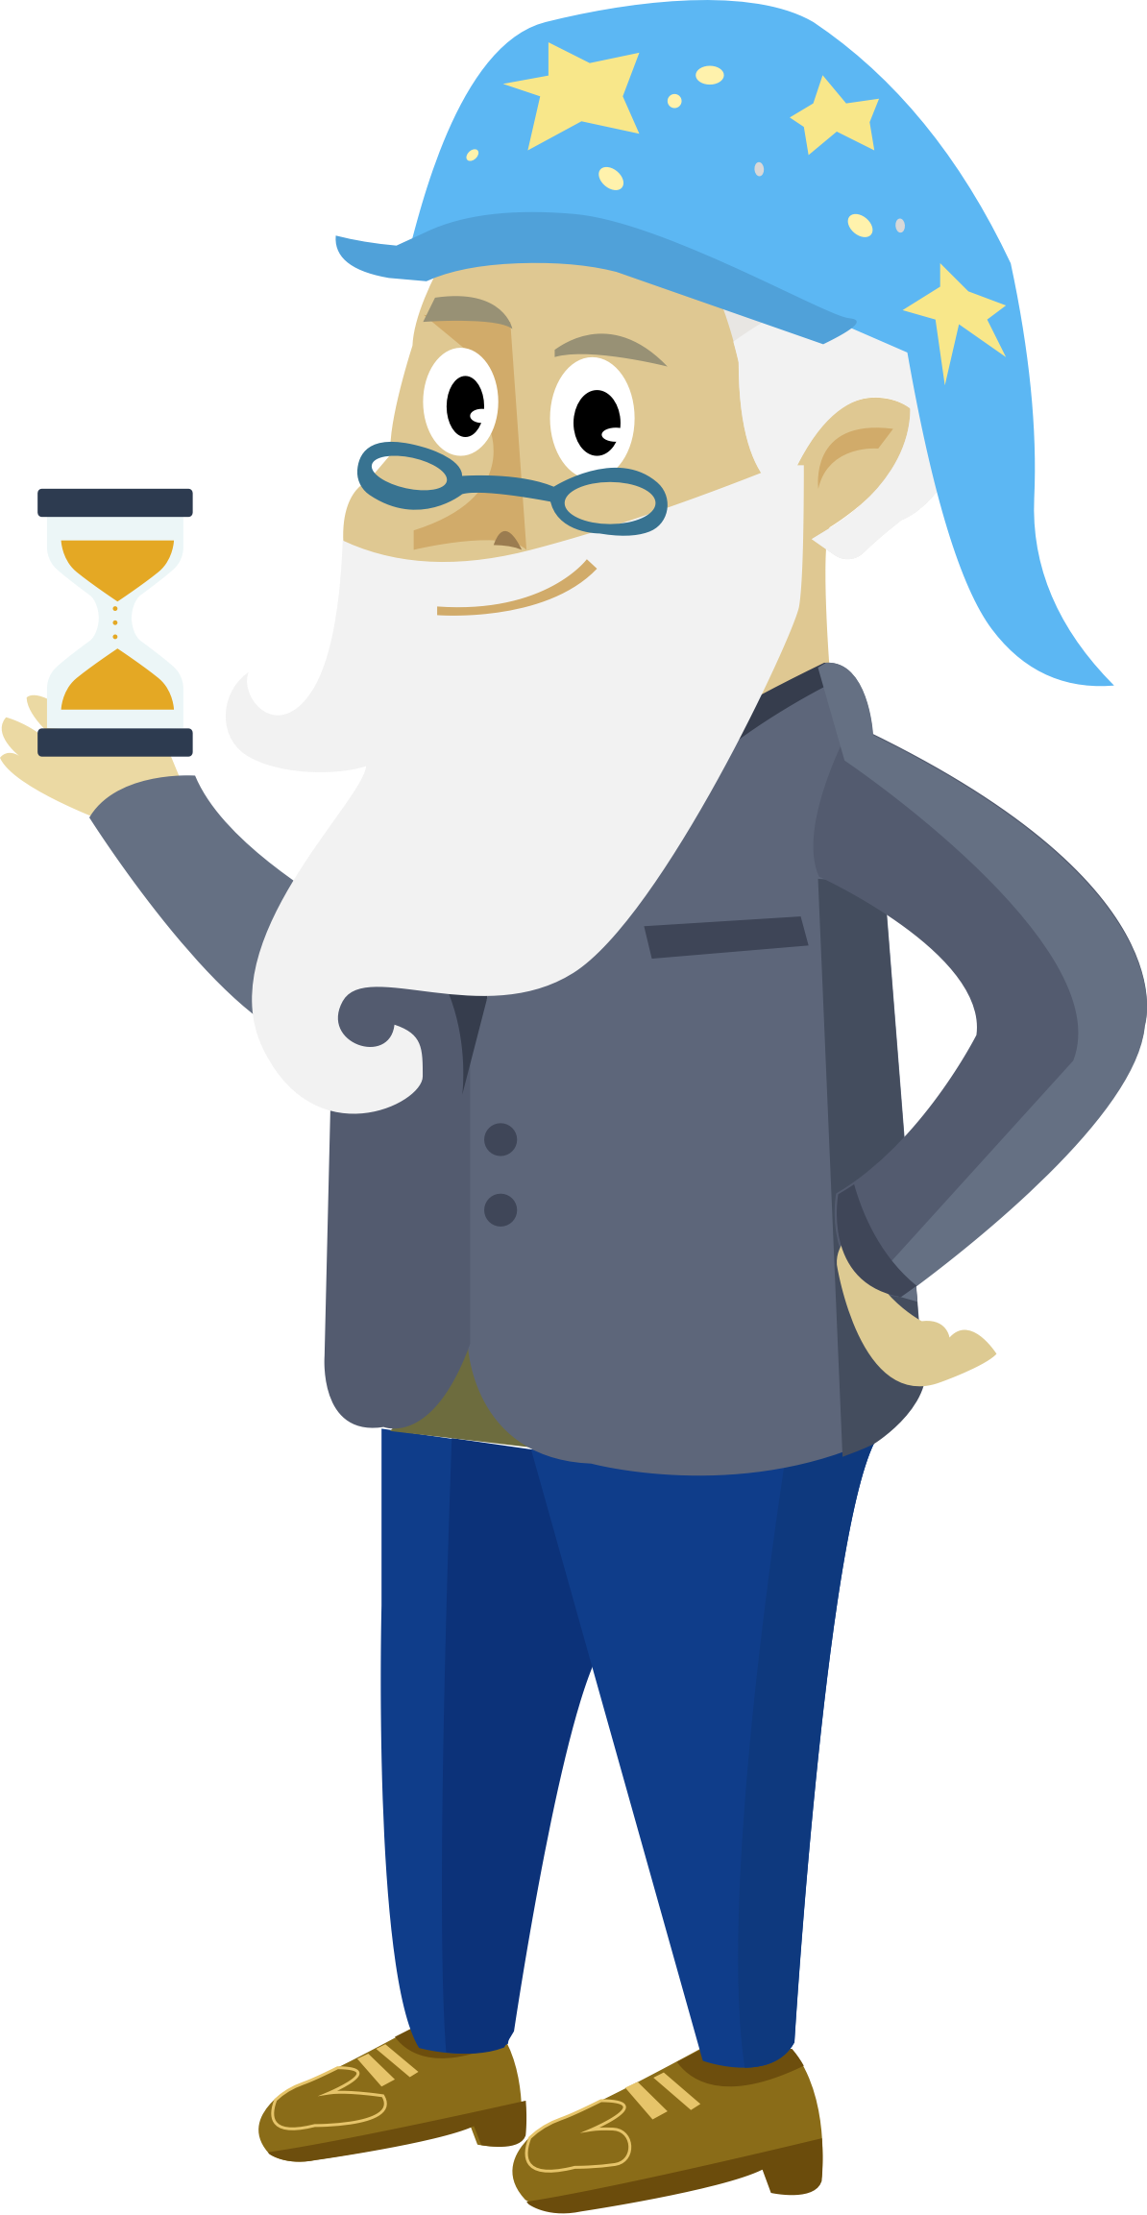

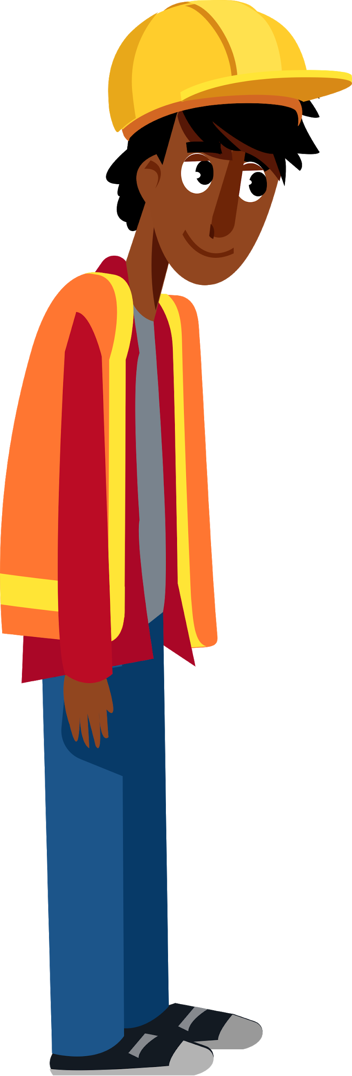
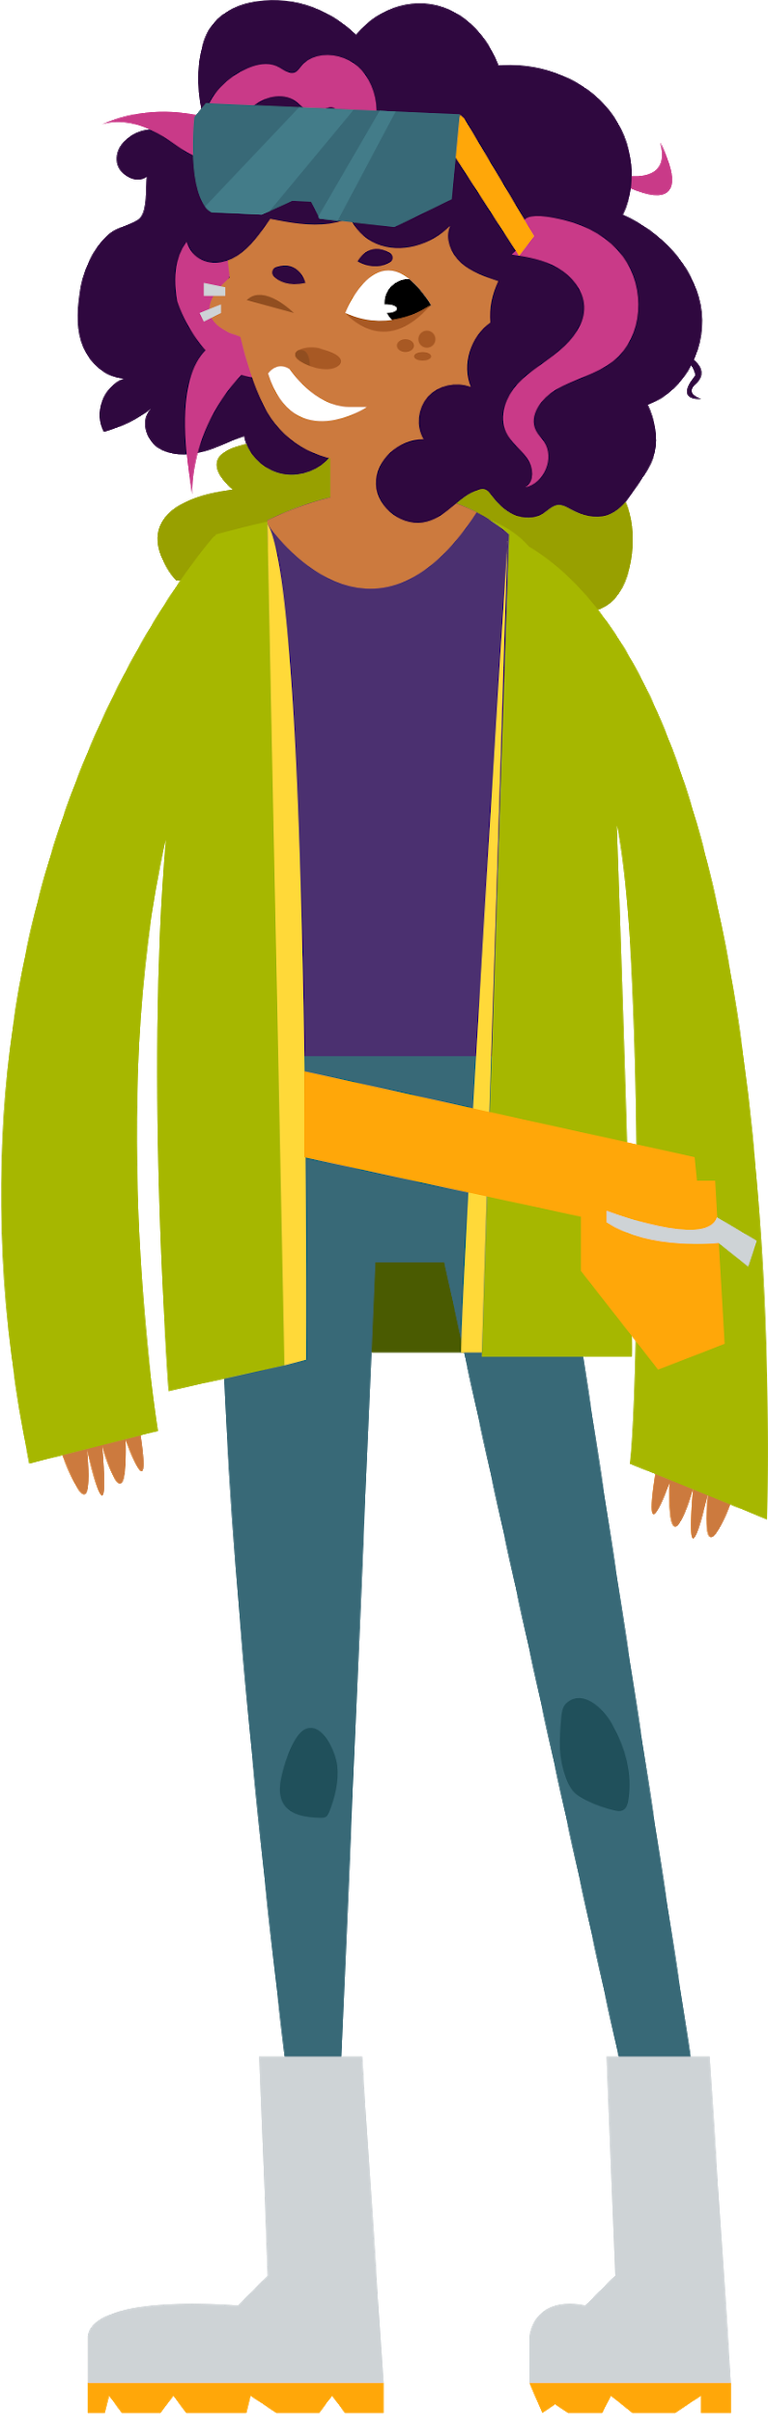
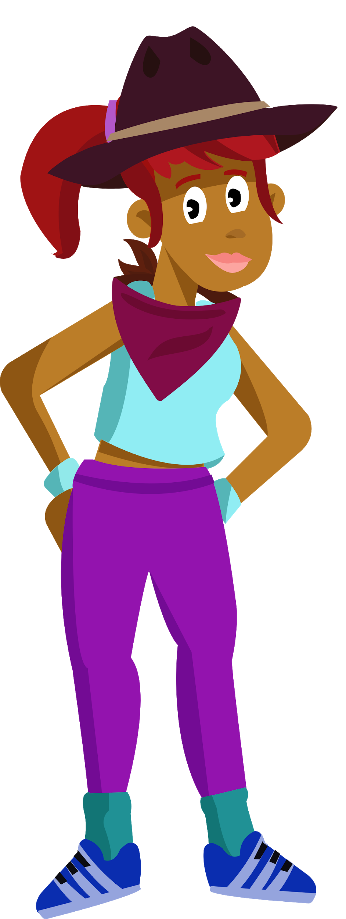
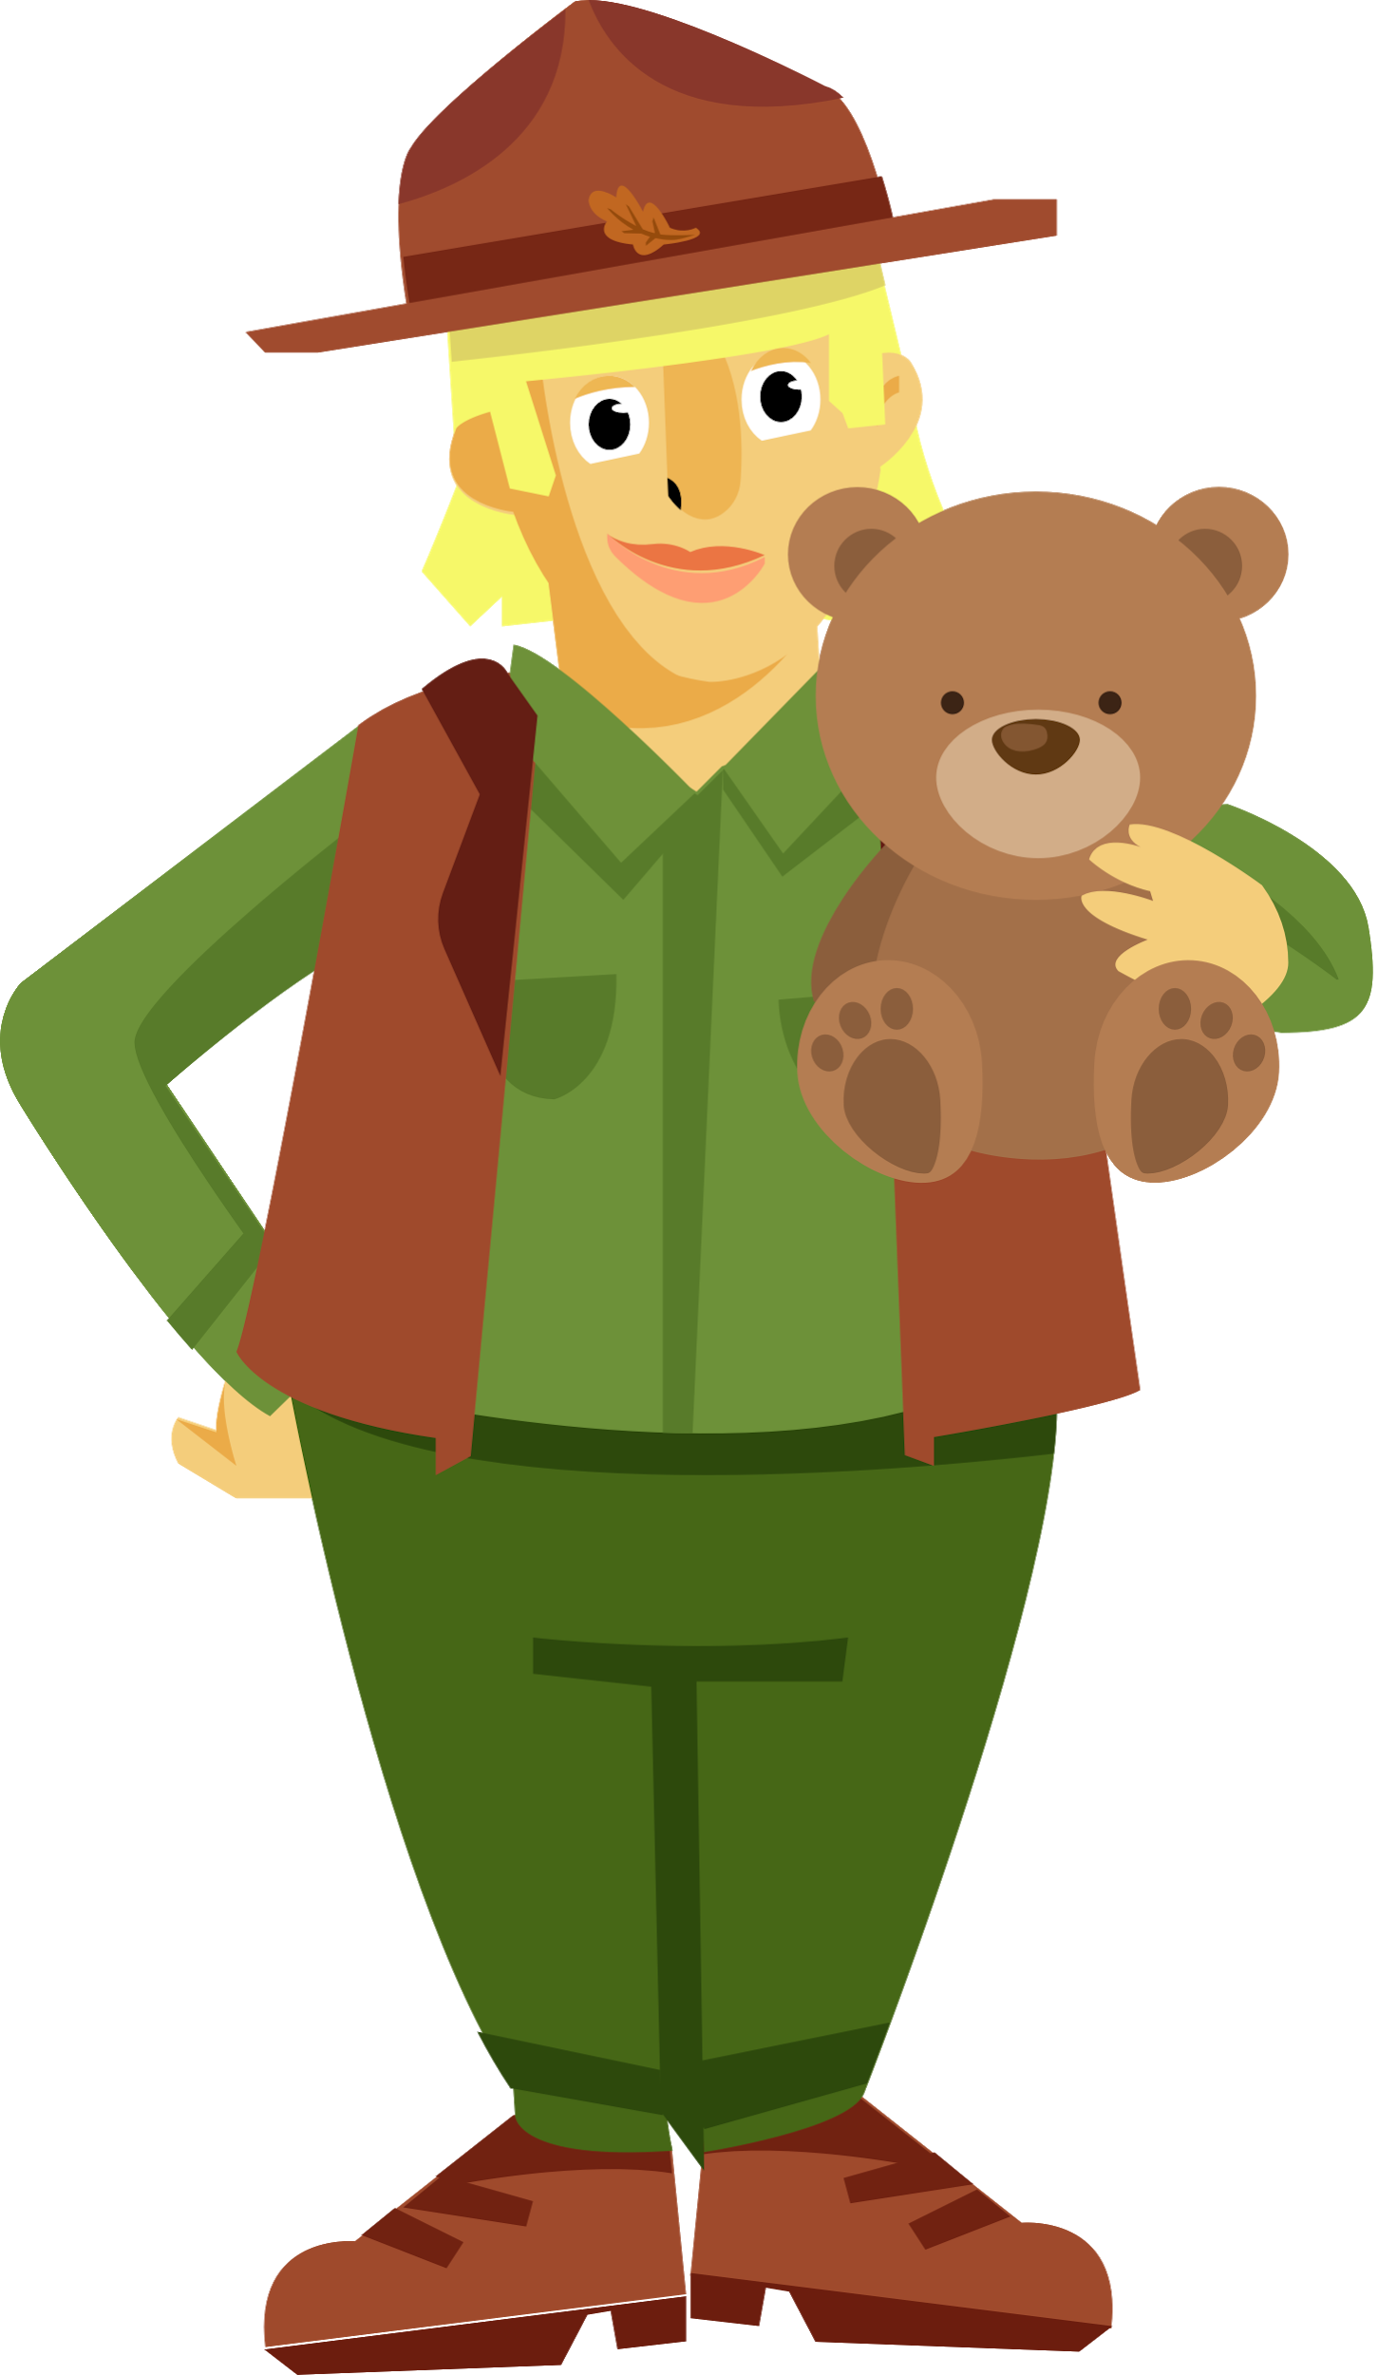
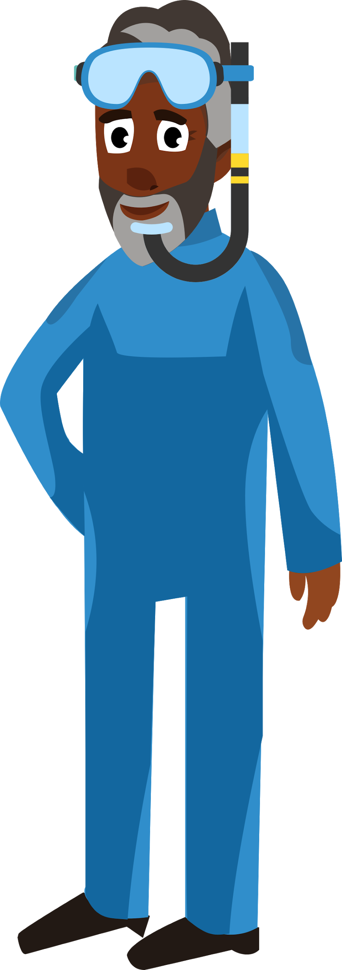
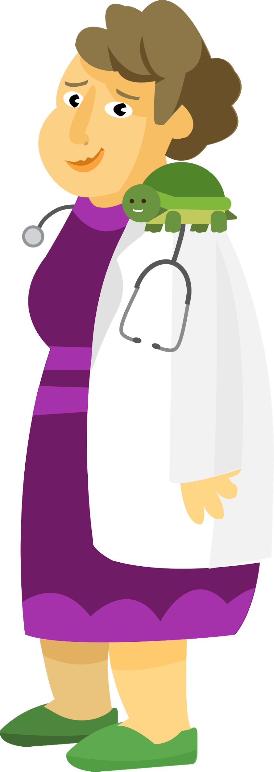
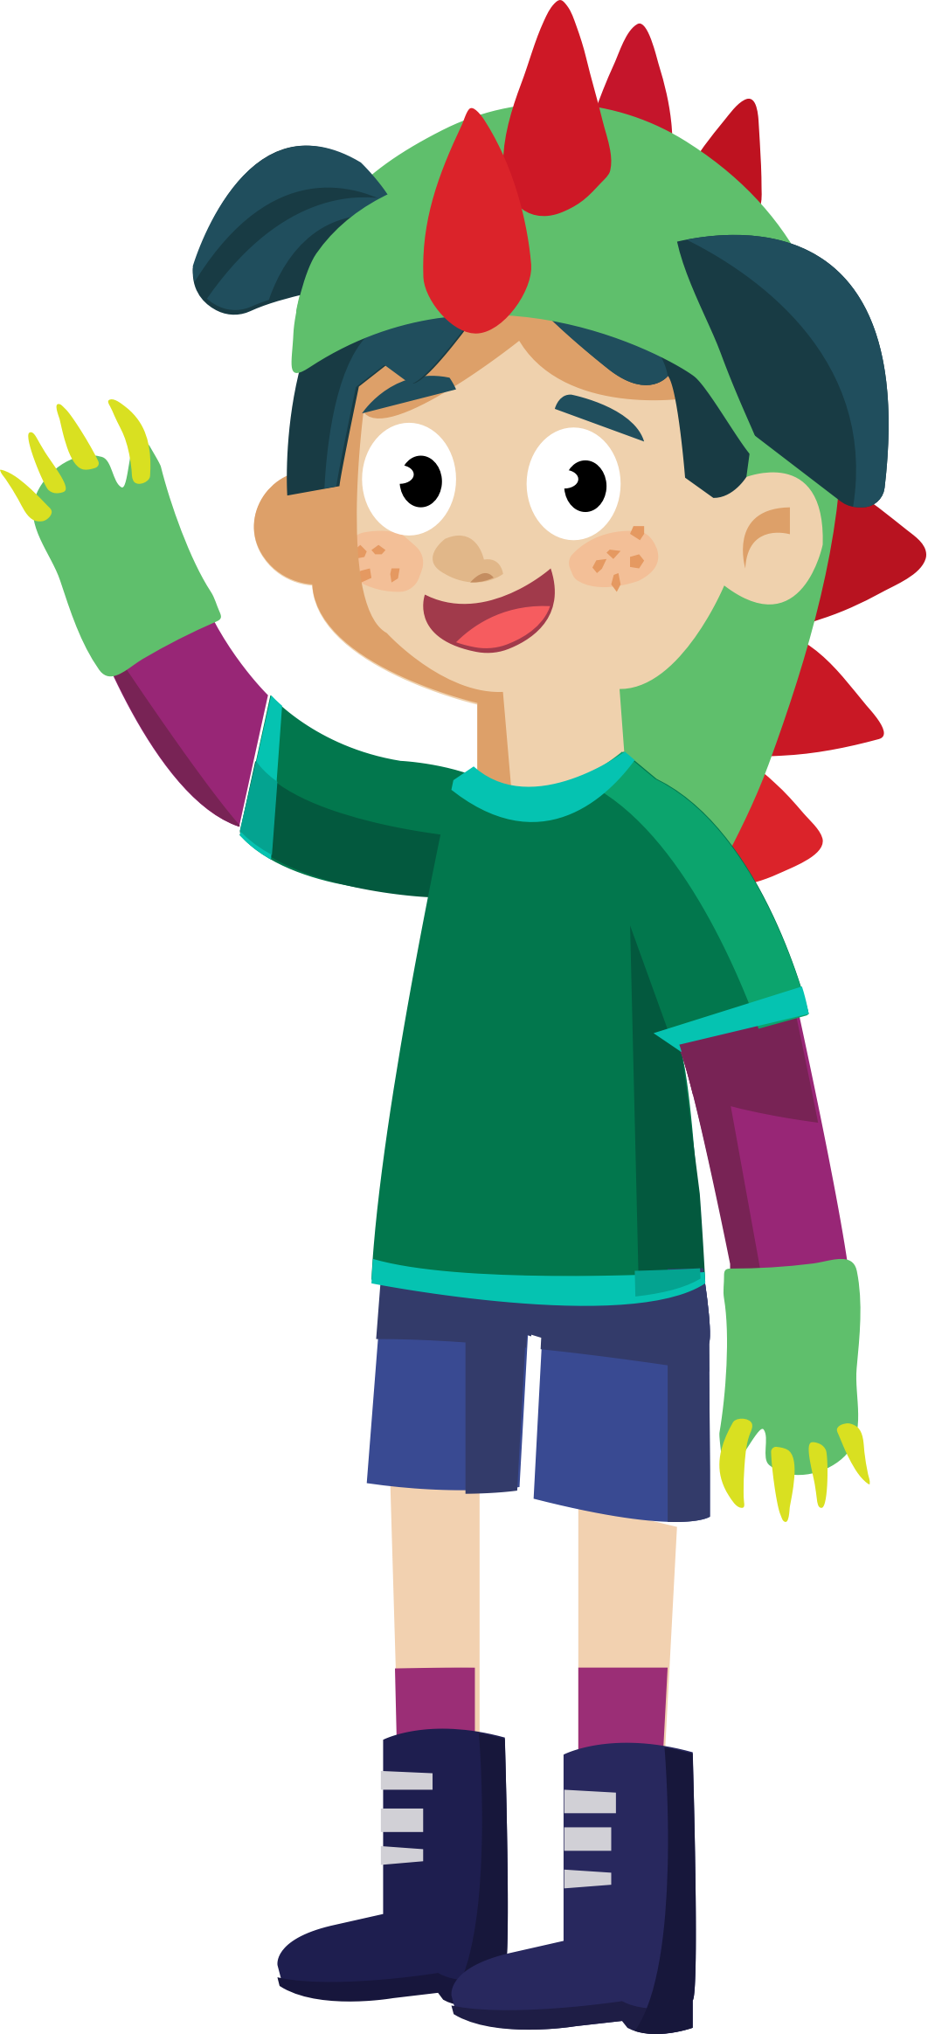
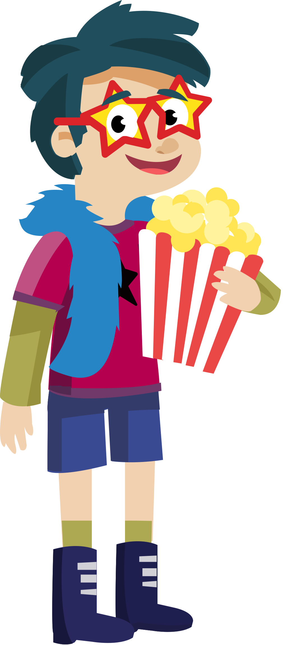
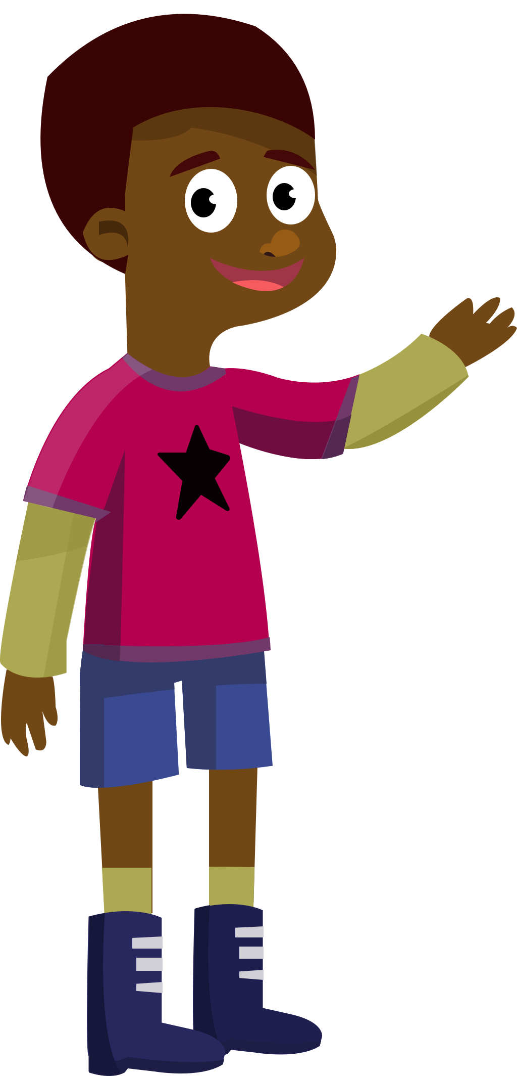
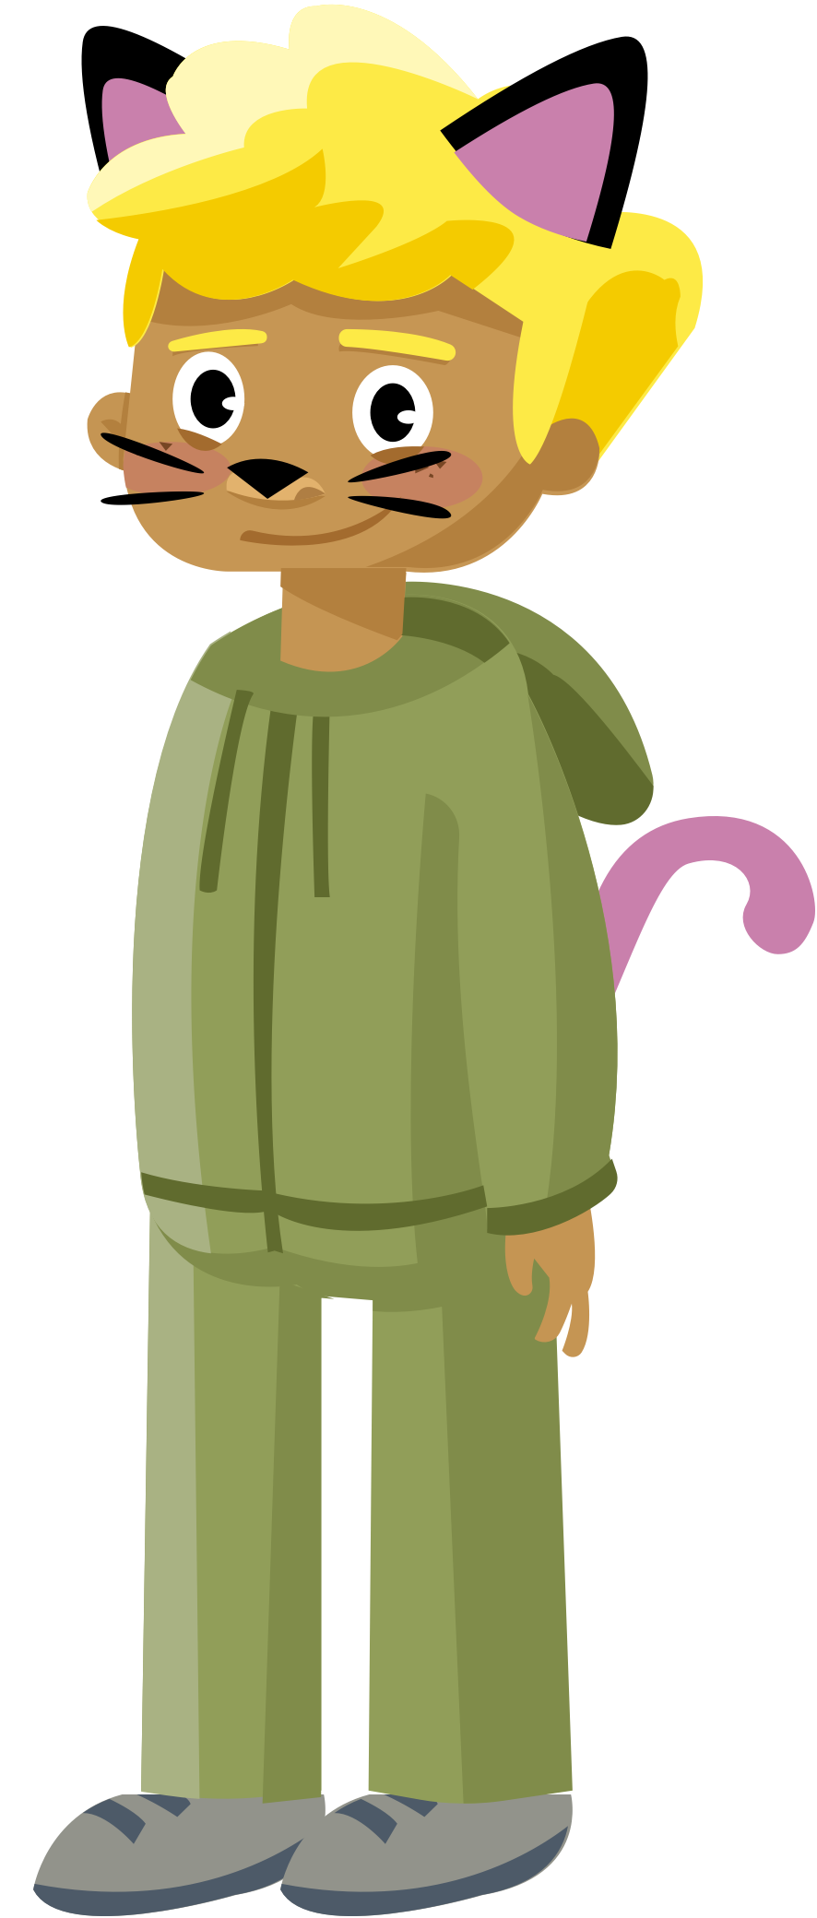
Bookerton Community
Notes:
Here are the community members that your students may encounter on their quests. Students will engage in a variety of skills-practice tasks/games with the people of Bookerton.

Slide 11
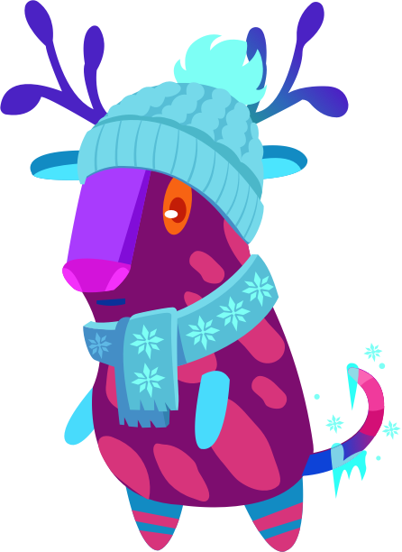
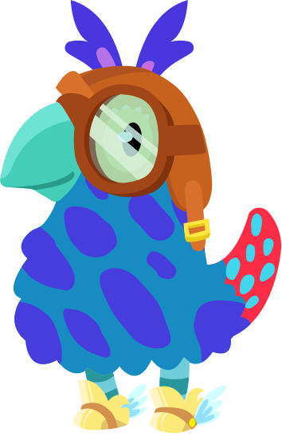
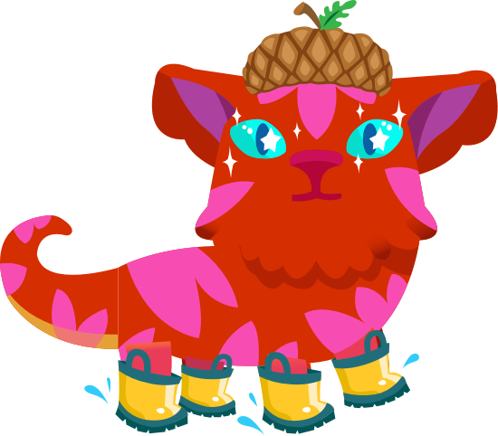
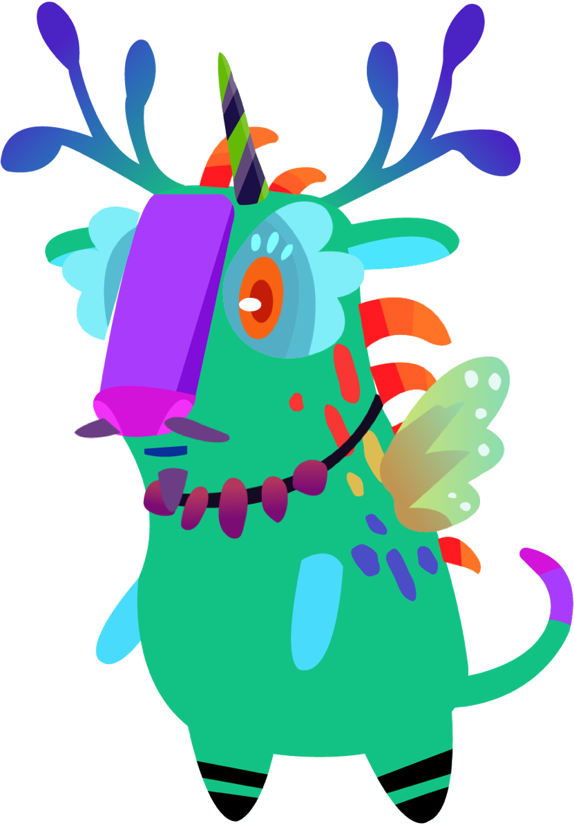

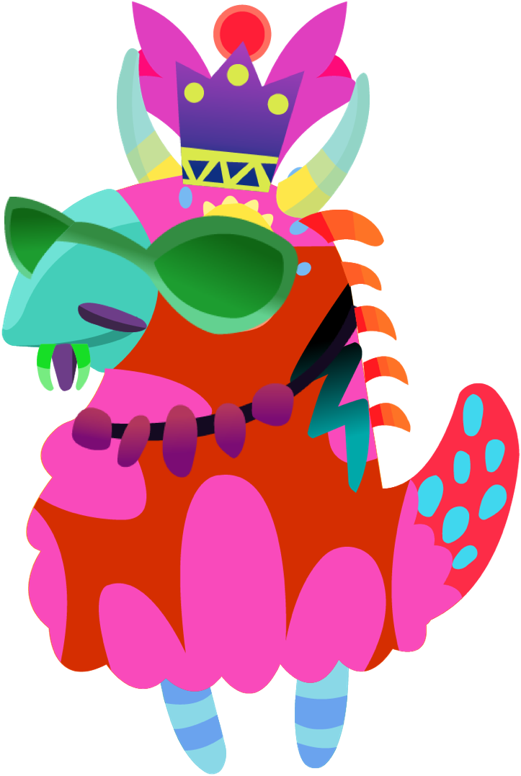

Curiosos: student avatars
Notes:
Here are some of the Curiosos that your students will engage with. A Curioso is a whimsical little creature (they don’t have names) that serves as a guide to students during their quests. The more games your students play, the more options they will have to accessorize their Curioso.

Slide 12


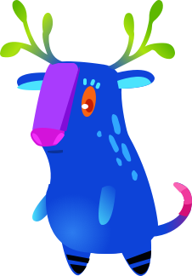



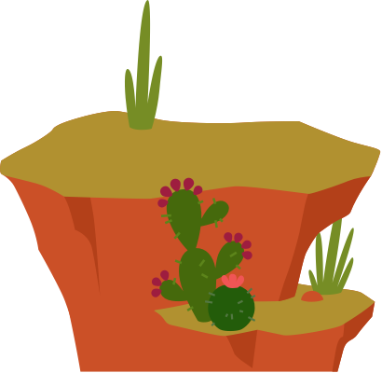
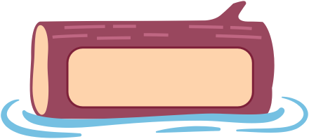




Game Elements: Word Plates
Word
Word
Word
Notes:
Use these to make the learning of a new word(s) fun and interactive!

Slide 13


















Game Elements: alphabet toasts
Notes:
Use the Alphabet Toasts to introduce letters, sounds, decode and blend words.

Slide 14






















Game Elements K-2

Slide 15




















Game Elements: 3-5

Slide 16



Game Elements: animated Curiosos
Notes:
They move too! Give your students a stretch break!

Slide 17

You are all doing an amazing job
Of trying to reach students with this new way of teaching.
If you think of something you’d love to see from our program as part of this collection - give me a shout at: lvila@amplify.com
Notes:
Additional resources and downloadable materials for Amplify Reading can be found at https://amplify.com/lausd-amplify-reading/

