Slide 1
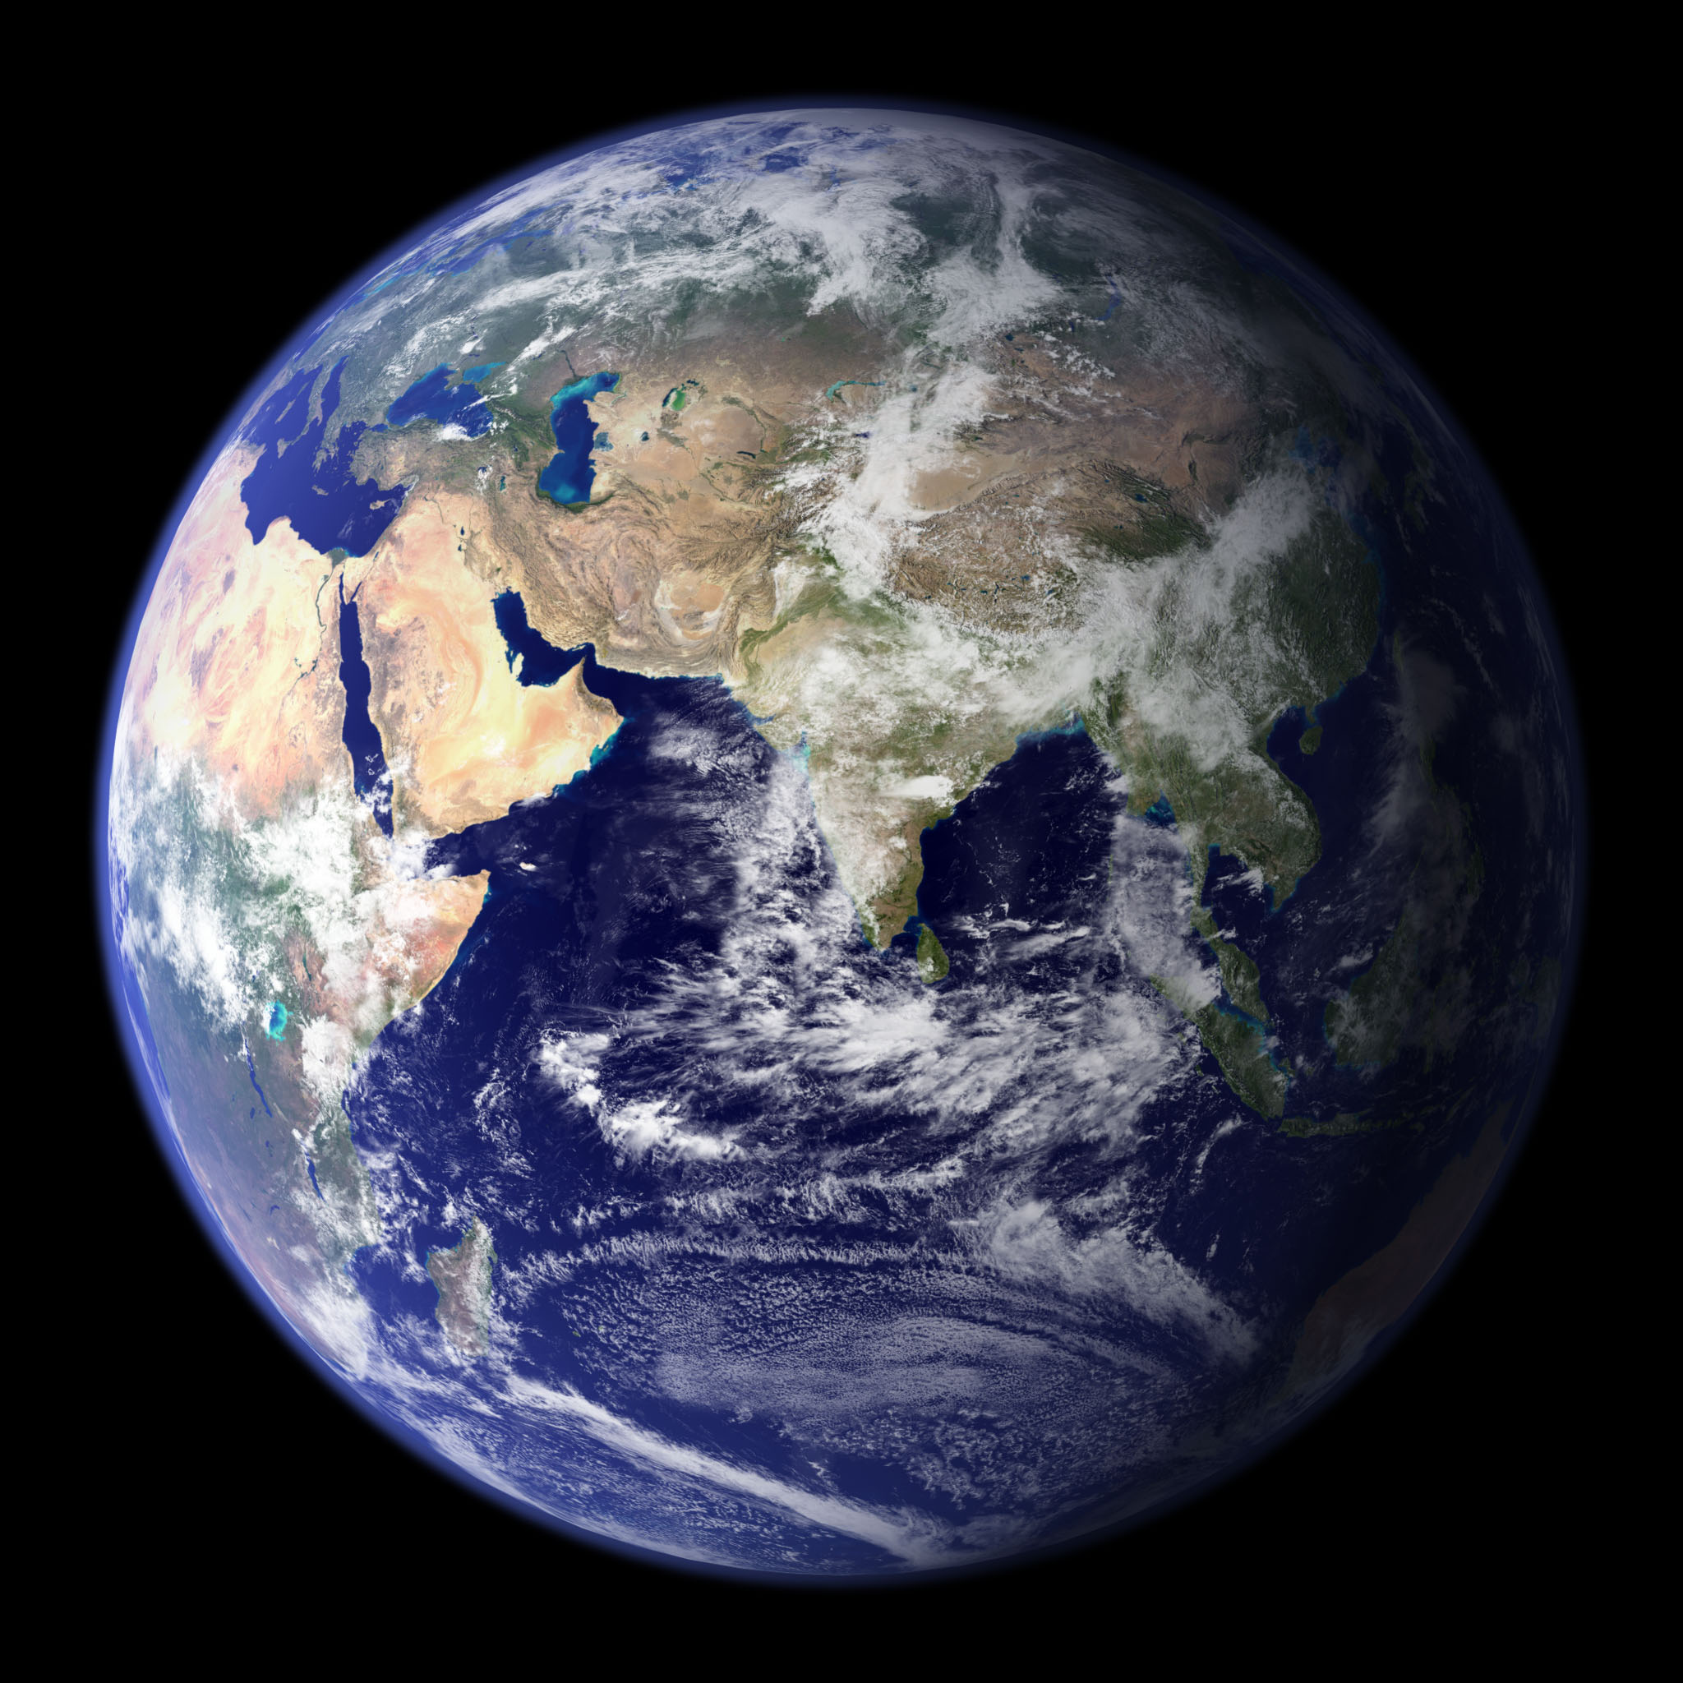
Where do we find water on earth?

Slide 2
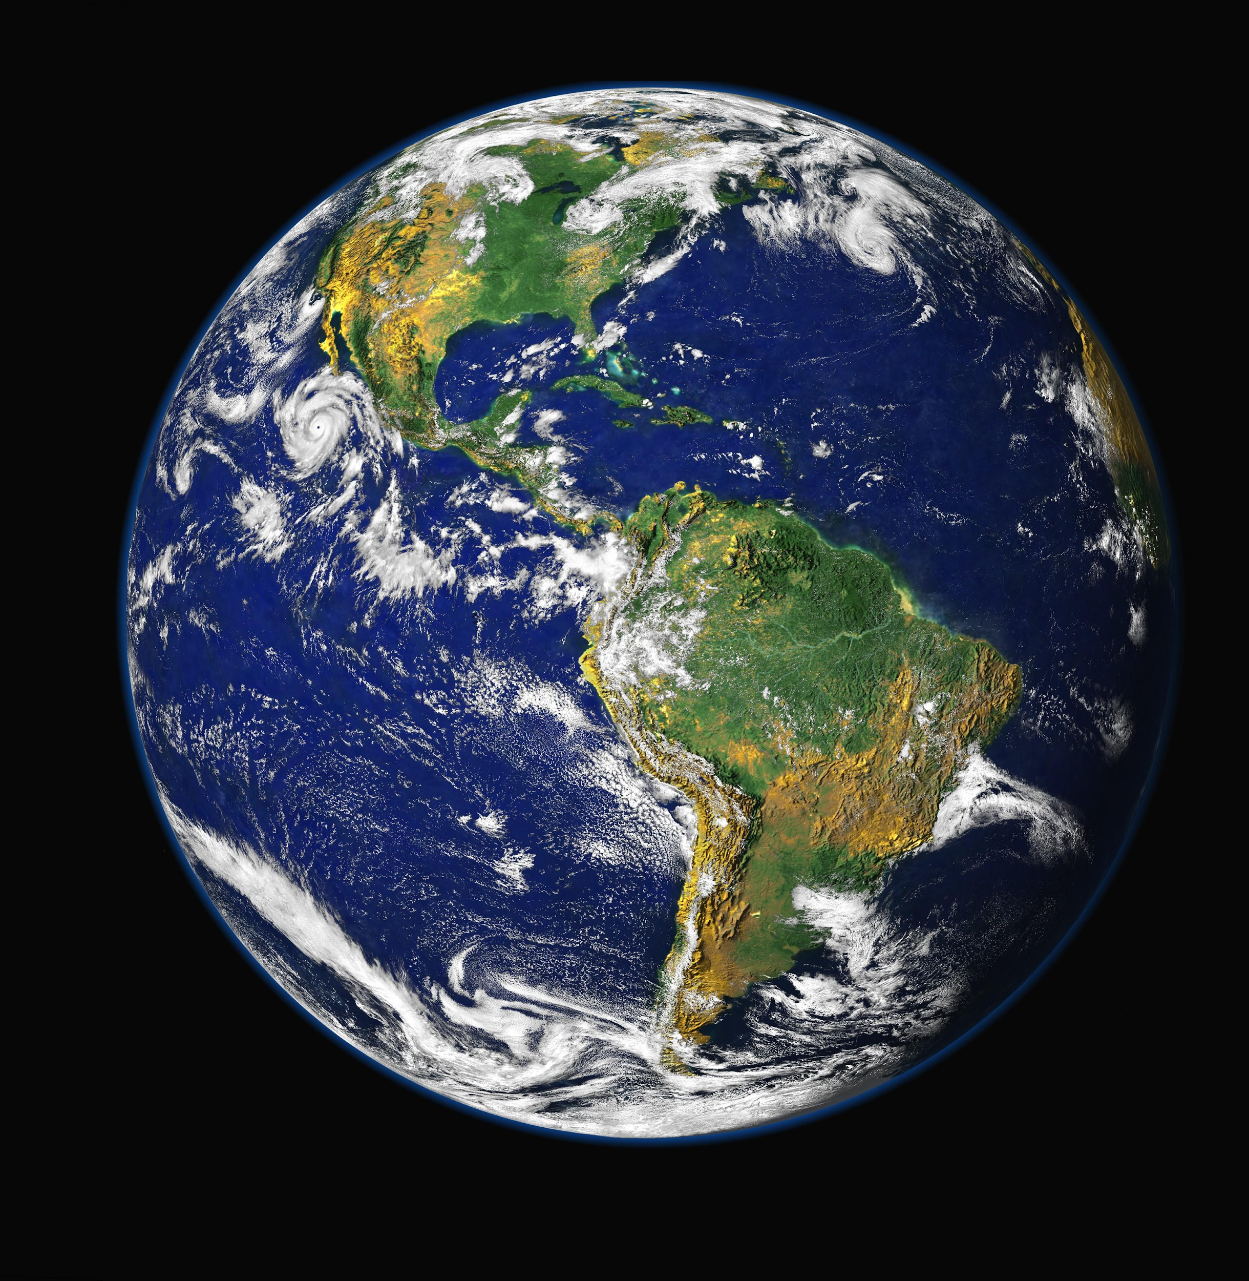
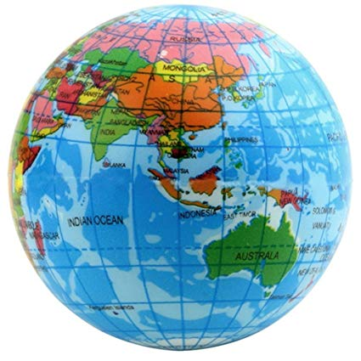
Let’s observe the planet Earth. What do you notice? What colors do you see?
Notes:
Students begin by observing an image of the Earth from afar. (for this part of the lesson a powerpoint with the images has been provided, however, feel free to use other resources: a globe, Google Earth, etc.)
Teacher says: “What do the blue parts of the Earth represent?” [The blue parts represent the Earth’s water]
Students are then asked to look for patterns in the Earth’s water, noting that similar patterns represent “bodies of water” with similar properties that scientists have given names to. As they look for patterns they should be thinking about any official names of bodies of water that they already know. After a minute of independent thinking students should turn and talk with their neighbors about what they notice. Once student discussion ends, share-out as a whole group while recording student thinking.

Slide 3
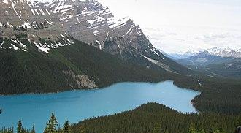
A lake is a larger body of fresh or saltwater surrounded by land.
Notes:
“What is a lake? How would you describe a lake? What surrounds the lake?”
Lakes and Ponds: Lakes or ponds are fully surrounded by land. They are often fed by streams or rivers and their source can also be a spring from an aquifer. Lakes, like rivers, can also supply drinking water to nearby cities. Many lakes and ponds are freshwater bodies of water, but some of the largest are saltwater.

Slide 4
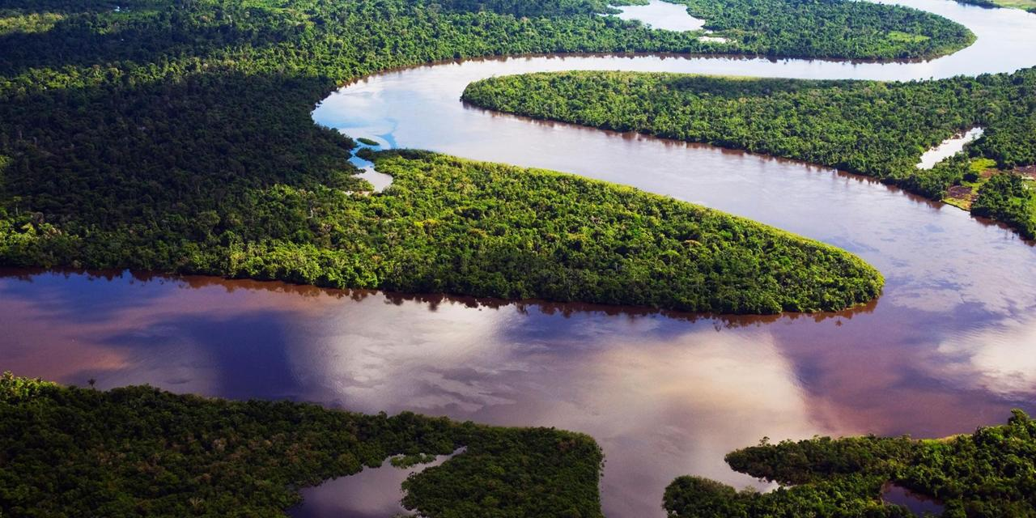
A river is a natural stream of water that may flow into a lake or ocean.
Notes:
“What is a river? How would you describe a river? How is a river different from a lake?”
Rivers: A river is a flowing, moving stream of water. Usually a river feeds water into an ocean, lake, pond, or even another river. Rivers can vary in size and there is no hard definition or rule on how big a flow of water must be to be categorized as a river.

Slide 5
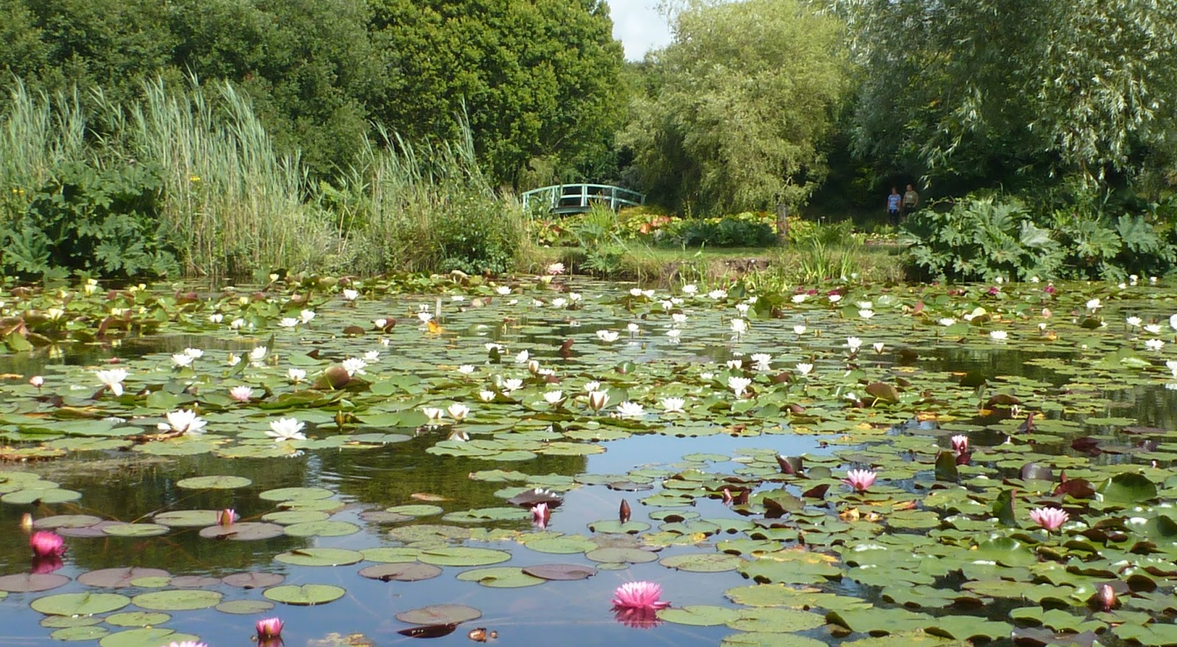
A pond is a body of standing water, either natural or artificial, that is usually smaller than a lake.
Notes:
“What is a pond? What do you see? How would you describe a pond? What makes a pond different from a lake and river?”
Lakes and Ponds: Lakes or ponds are fully surrounded by land. They are often fed by streams or rivers and their source can also be a spring from an aquifer (an underground source of water). Lakes, like rivers, can also supply drinking water to nearby towns and cities. Many lakes and ponds are freshwater bodies of water, but some of the largest lakes are saltwater.

Slide 6
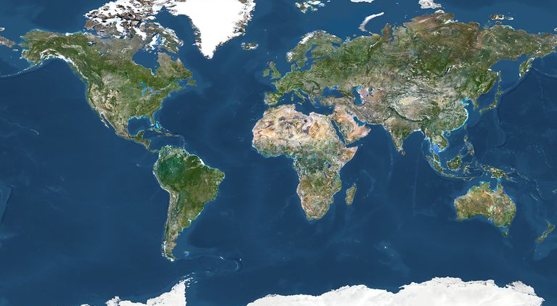
An ocean is a large body of saltwater that surrounds a continent.
Notes:
“What is an ocean? How would you describe an ocean? How is an ocean different from the other bodies of water? *What patterns did you notice from looking at the photographs? How can you describe each body of water?”
Oceans: The largest bodies of water on Earth. Although we do name the different regions of the ocean - Pacific, Atlantic, Indian, Arctic, and Southern - it is really just one large contiguous body of water.
Teacher says: “Those are the four main bodies of water you need to include in your birds-eye-view map. However, there are many other kinds of bodies of water - can you think of any others?” Discuss and record student responses. (This part of the lesson works particularly well if the teacher has the ability to show extra student responses, such as by searching for them online and putting images up on a board)

Slide 7
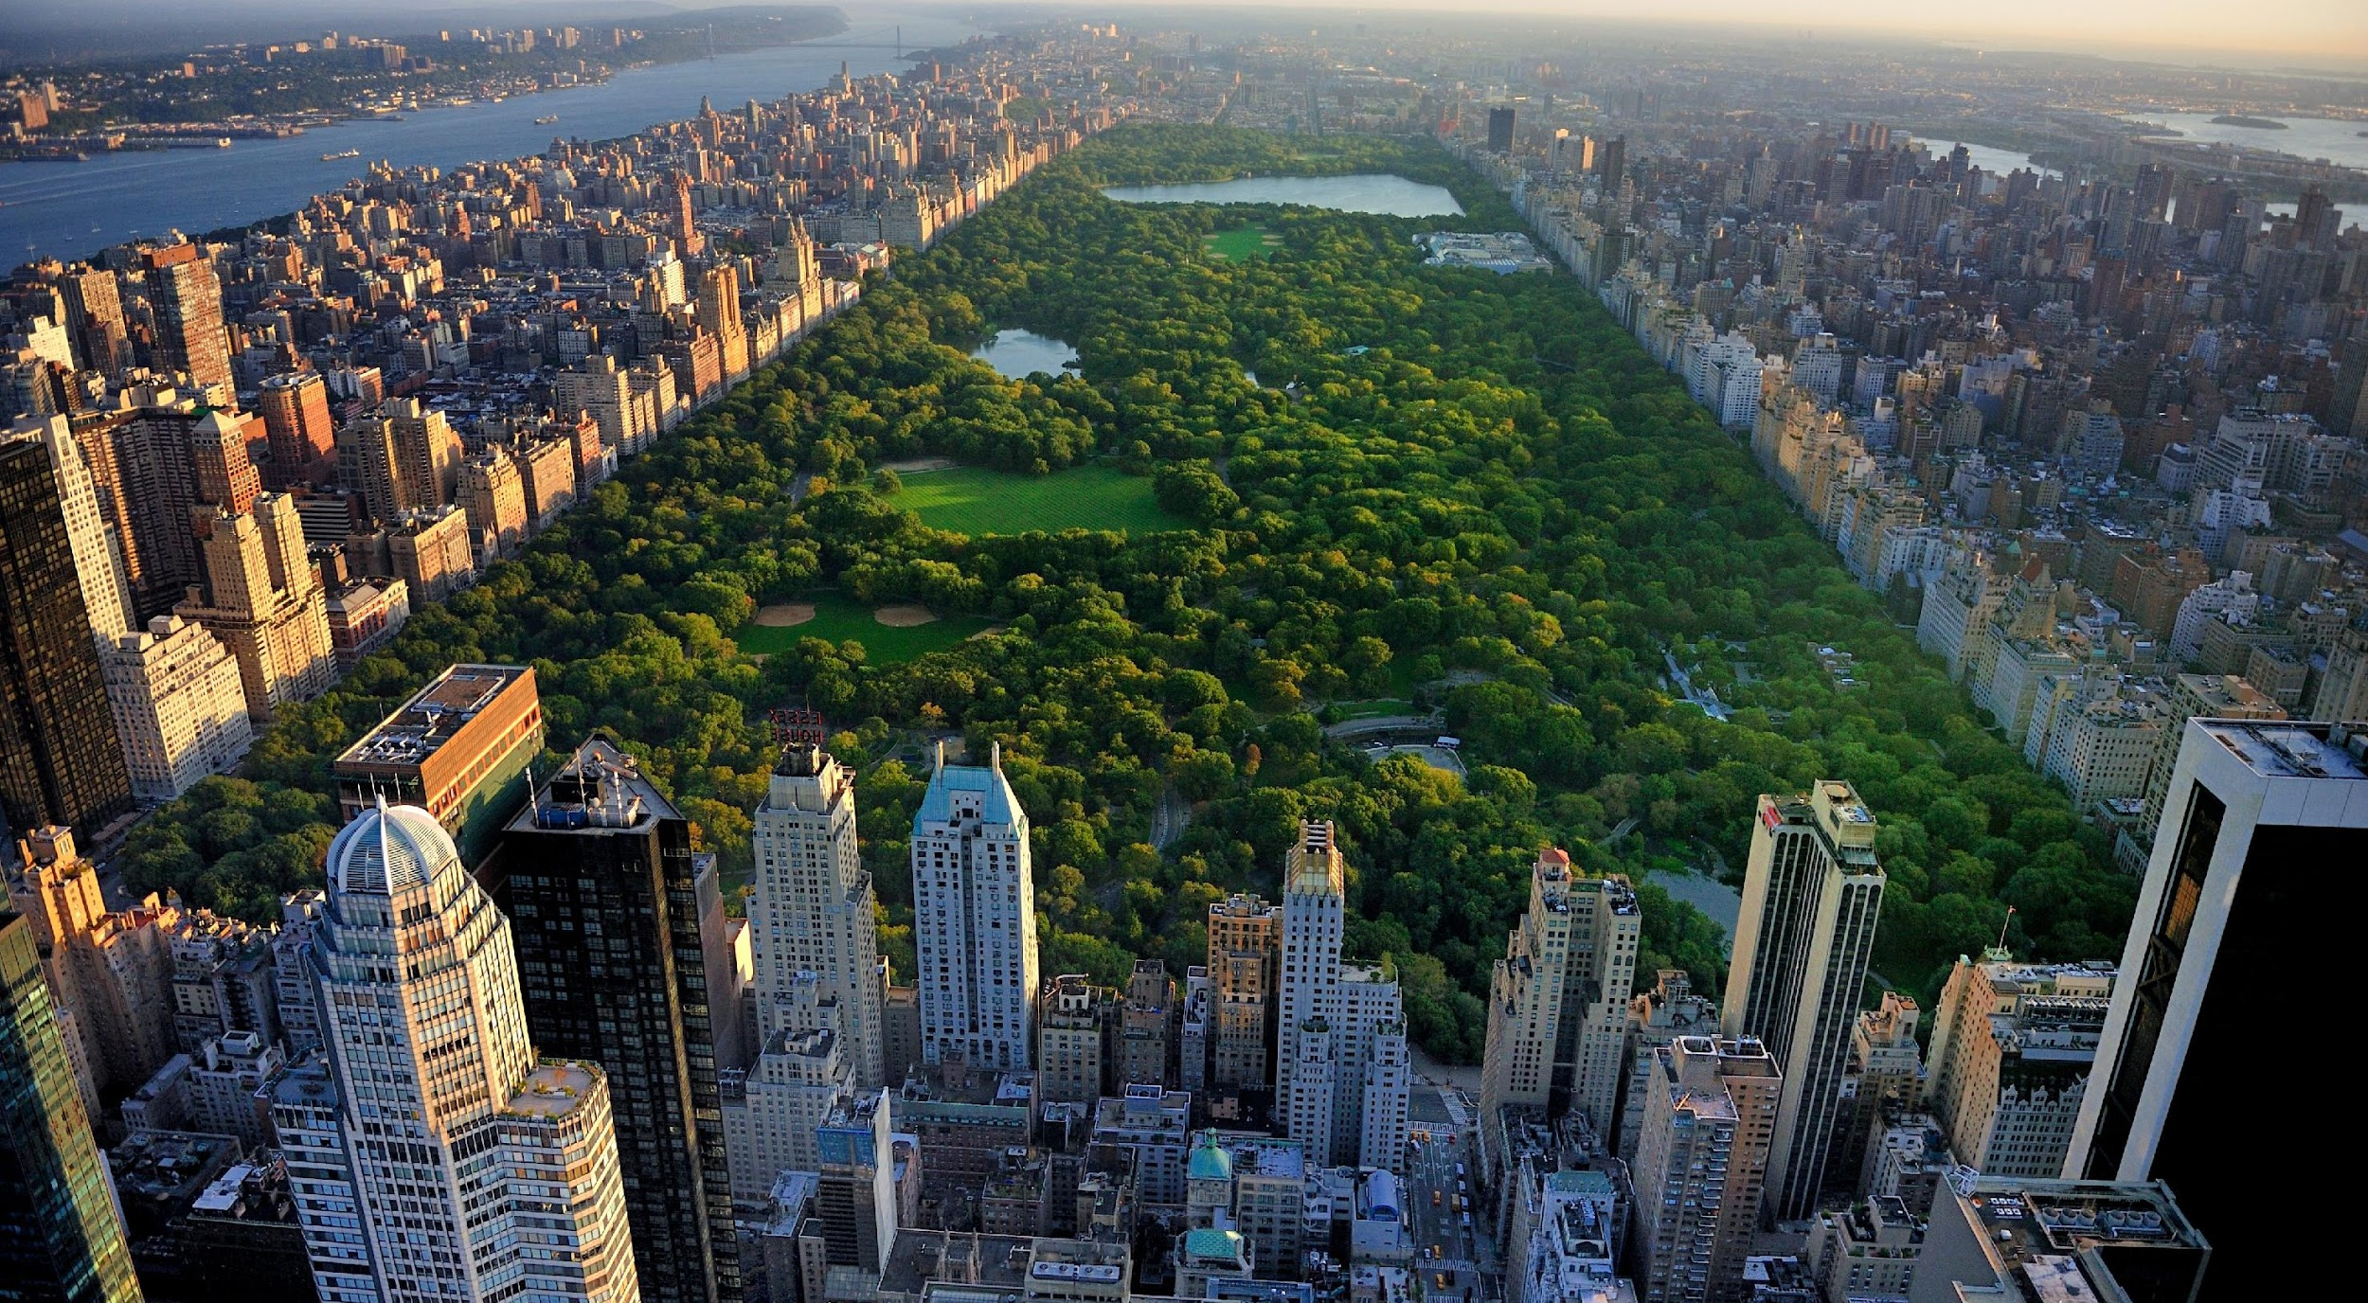
Activity: Create your own Bird’s Eye View Map!
What does “bird’s eye” mean?
Notes:
Teacher says: “Today, you will be making bird’s-eye-view maps of a part of the world that you are creating out of your imagination, that focuses on the bodies of water. First, we need to learn the properties of a few really important bodies of water, and what they look like.”
“What city is this? What does the “green” represent? What does the “blue” represent? What does a bird’s eye view mean?”
The teacher then models how to recognize the properties of four main bodies of water: oceans, lakes, ponds, and rivers.

Slide 8


Activity: Create your own Bird’s Eye View Map!
Map Criteria:
Materials: Grid Paper
Bird’s-eye-view
Must include: Oceans, Lakes, Ponds, Rivers
Can include other bodies of water and landforms
All bodies of water and landforms must be labeled
Map must be in true-color
Notes:
Now you’re going to create a bird’s-eye-view map of a part of the world you are creating out of your imagination. Your map must include the four major bodies of water we just reviewed, but can include other bodies of water and landforms as well. Before we start, let’s review the properties of a bird’s-eye-view map.”
Materials: Grid Paper (or any other template of your choice)

Slide 9
Gallery Walk and Final Debriefing
Walk around the classroom.
Give feedback to your peers by writing a comment on a sticky-note.
Debrief Questions:
What patterns/themes do we notice about the maps in our gallery?
What bodies of water (besides the main four) did people include in their maps?
Investigative Phenomenon Questions:
Does the water in each body of water stay in that body of water? (For example, does the water in a river, stay in a river?)
If the water does move, then how does it move from one place to another?
Notes:
At the end of student work time, instruct students that they will be doing a “gallery walk”/ “museum share”, so just like at a museum they need to make sure their maps are properly on display by labeling their maps with a title and the name of the map engineer and making sure their workspaces are clean and organized.
Students then participate in a gallery walk, where they can leave feedback comments on sticky-notes on their peers maps.
At the end of the gallery walk students return to their own maps, read any feedback comments, and then come to the rug for a final debrief.
Debrief Questions:
What patterns/themes do we notice about the maps in our gallery?
What bodies of water (besides the main four) did people include in our maps?
Investigative Phenomenon Preview Questions:
Does the water in each body of water stay in that body of water? (For example, does the water in a river, stay in a river?)
If the water does move, then how does it move from one place to another?

Slide 10
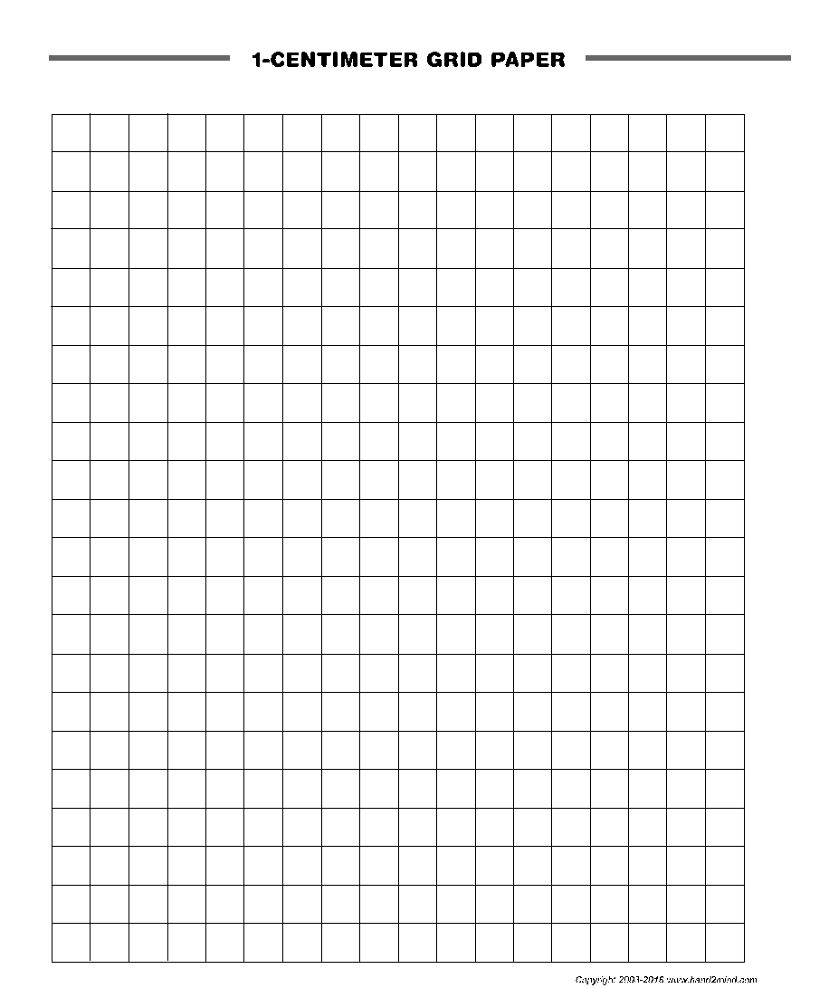
Notes:
Teacher models how to create an bird’s eye view map of an imaginary place. Reinforce the idea that even though their maps are coming from their imagination, they must be realistic and include, at least, the four bodies of water that were modeled. While modeling, review the properties of a bird’s-eye-view map.

